Slide 1
CME Group Foundation
2021-22 Scholars

Slide 2
CME Group Foundation Scholars 2021-22

Slide 3
CME Group Foundation Scholars 2021-22

Slide 4
CME Group Foundation Scholars 2021-22

Slide 5
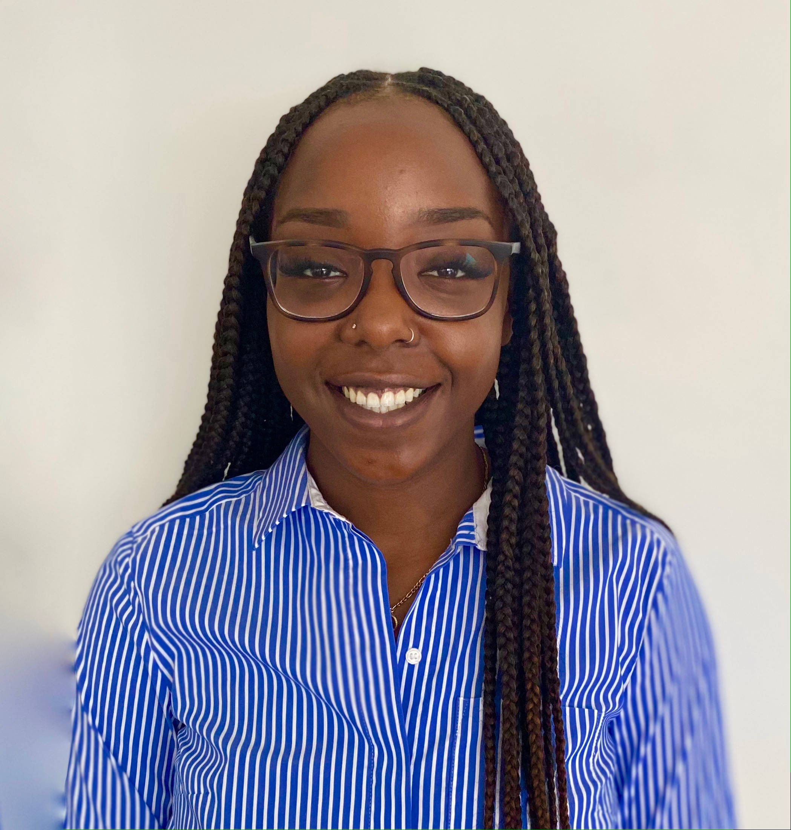
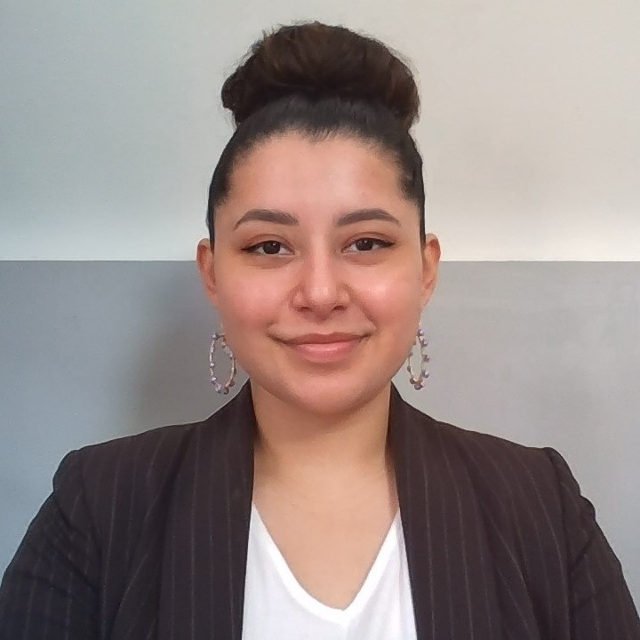
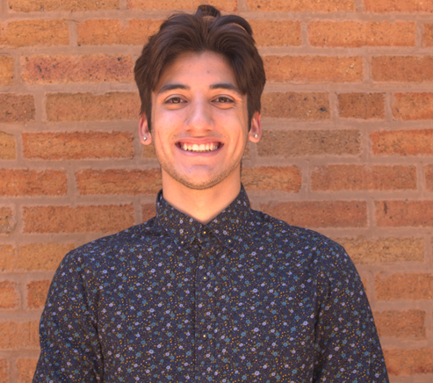
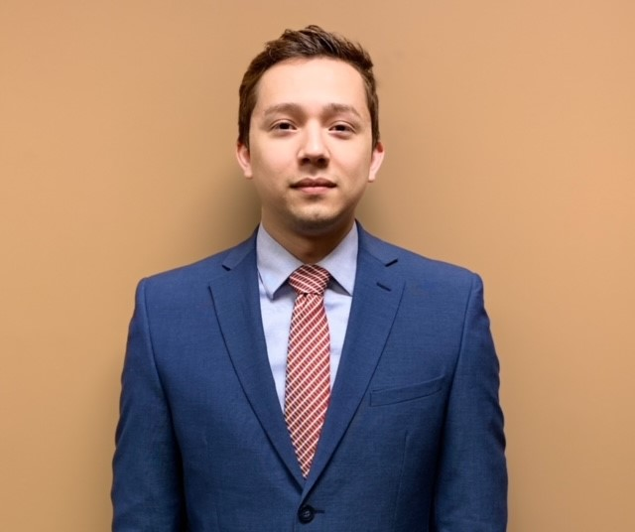
Jada Aduda will be a senior at Loyola University Chicago double majoring in Finance and Information Systems. She grew up in Brooklyn Park, MN and graduated from Osseo Senior High. Jada’s interests include traveling, trying new foods, and spending time with friends and family. Her career goal is to become an investment banker and create a non-profit organization.
Krystal Aranda is a junior at the University of Illinois at Chicago majoring in Finance. She grew up in Chicago and graduated from Whitney M. Young Magnet High School. Her interests include running her small business, 606 Stitches, sewing, and dancing. Her career goal is to uplift underprivileged communities through corporate investing.
Anthony Bañuelos is a senior at Illinois Institute of Technology majoring in Computer and Cyber Security Engineering. He grew up in Chicago and graduated from Lincoln Park High School. His interests include eSports, baseball, and spikeball. His career goal is to work within Cyber Defense Operations.
Alberto Briones is a senior at Northern Illinois University majoring in Operations and Information Management. He grew up in San Marcos, TX and graduated from San Marcos High School. His interests include reading, gaming, learning languages, and volunteering. His career goal is to work as a professional operations manager.

Slide 6
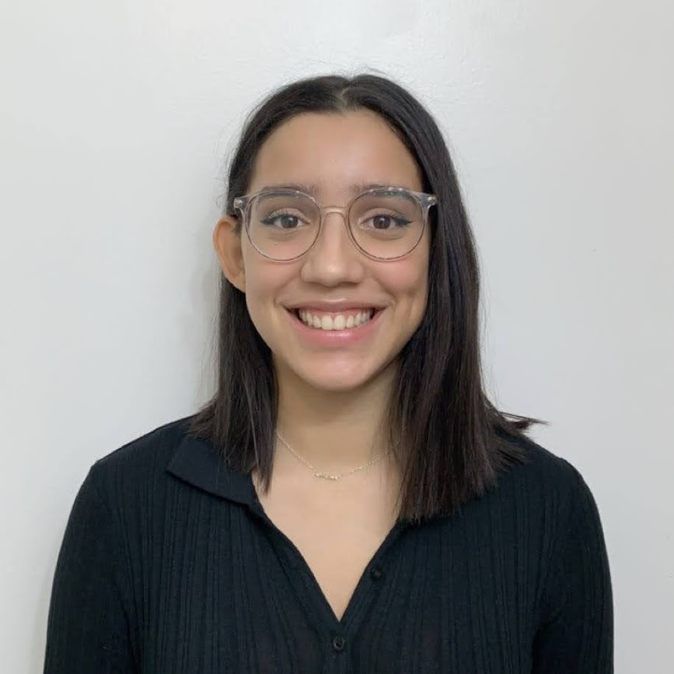
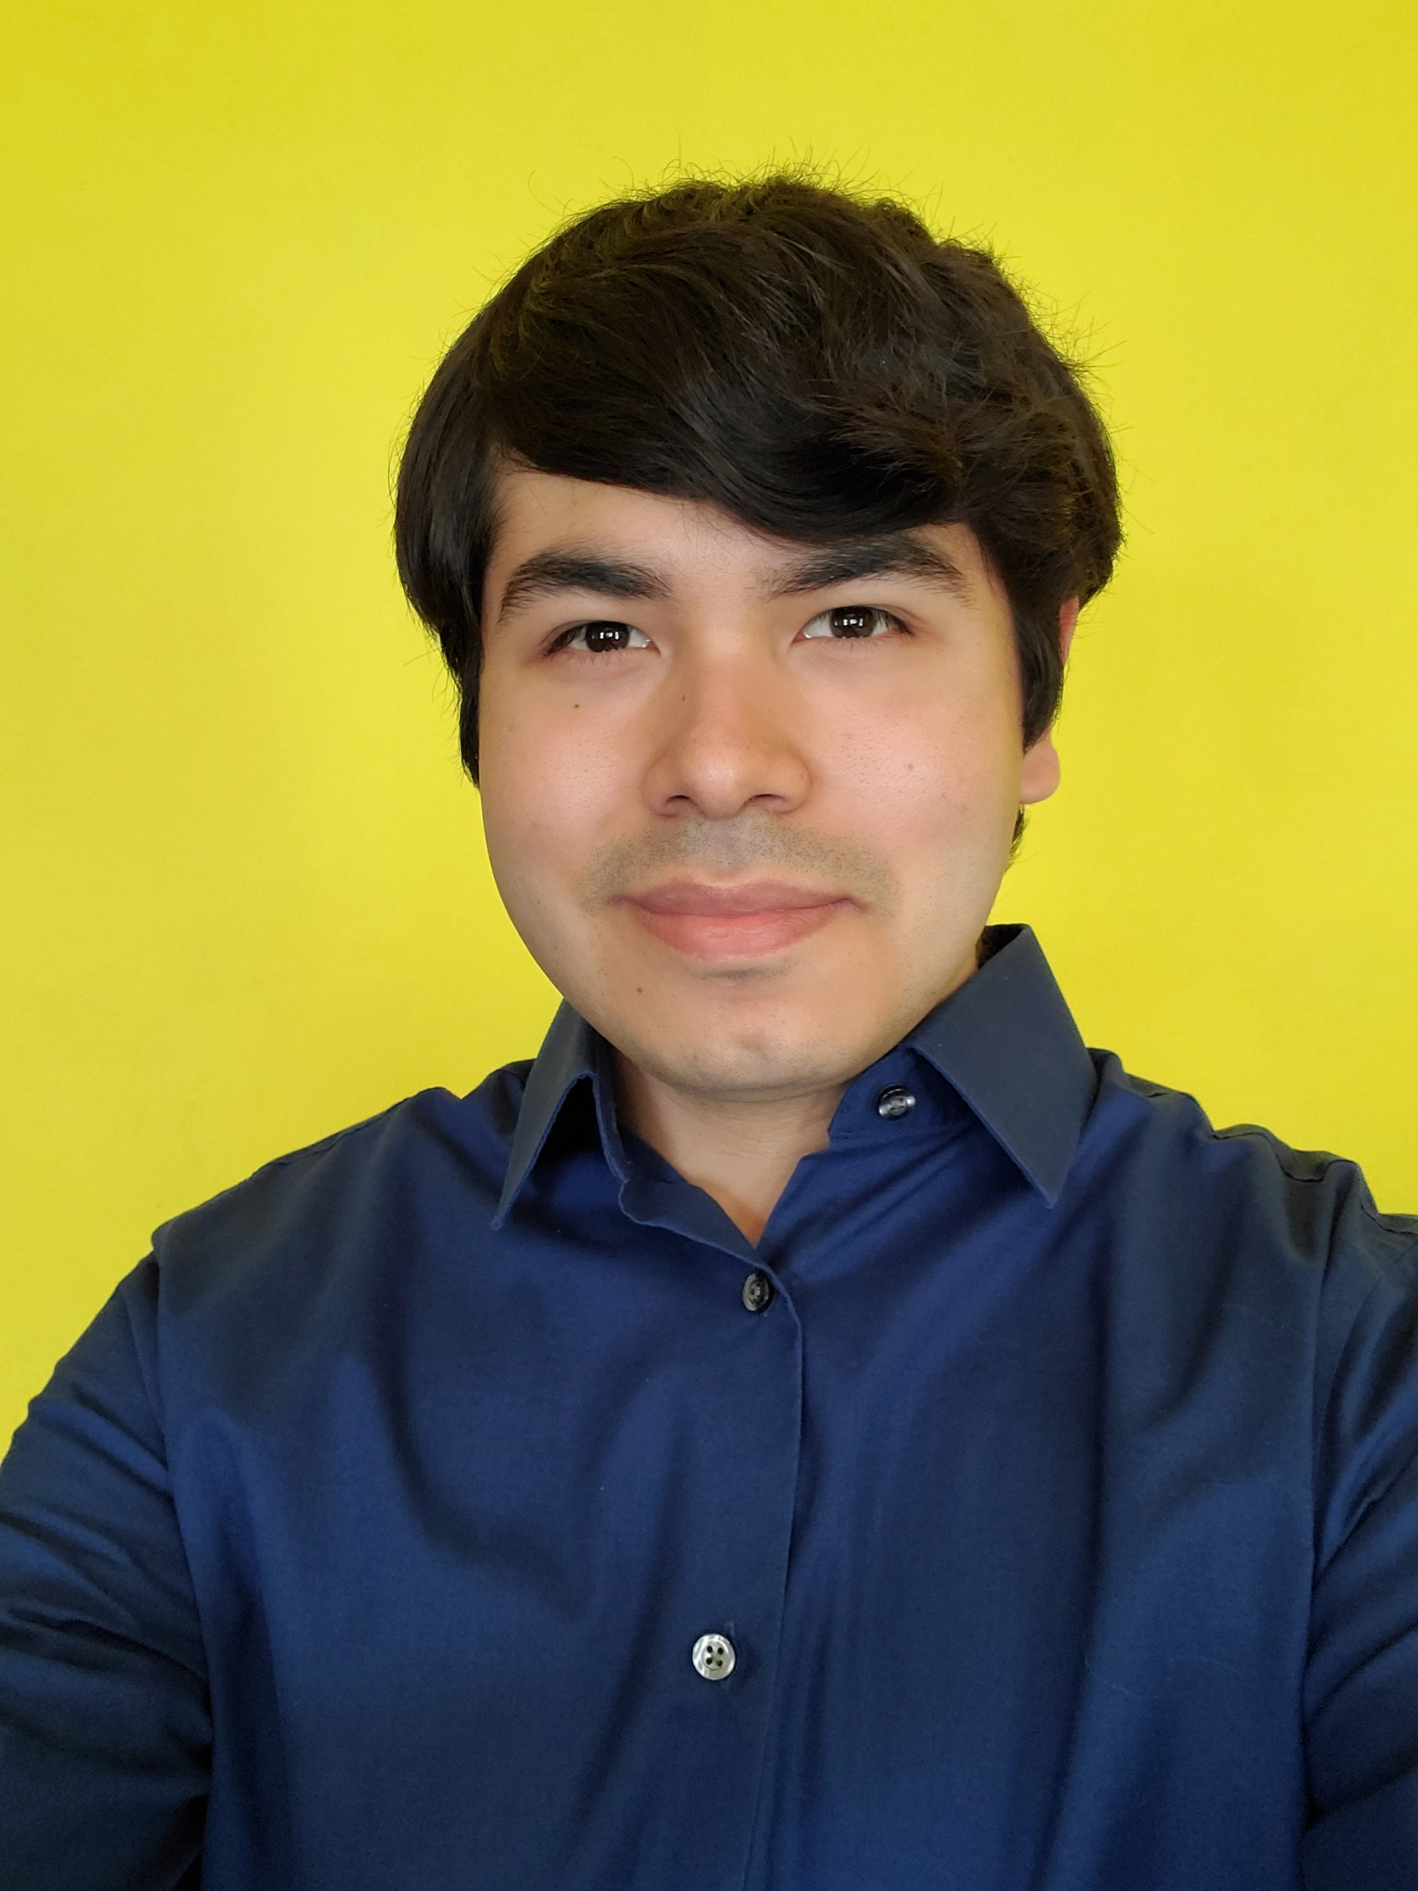
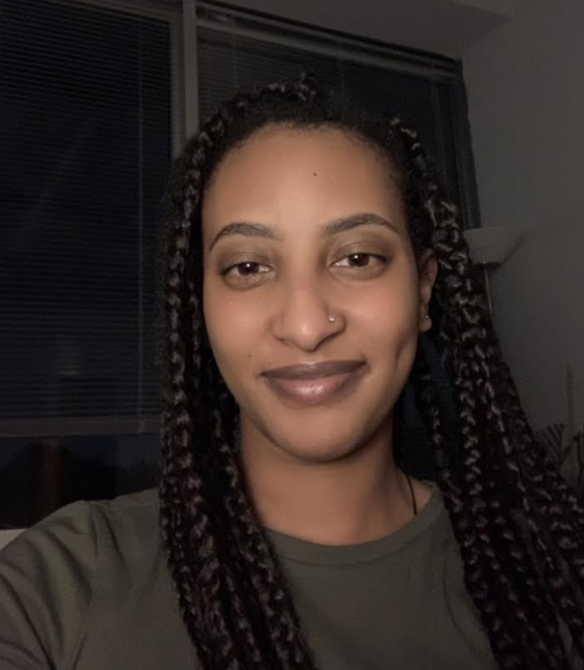
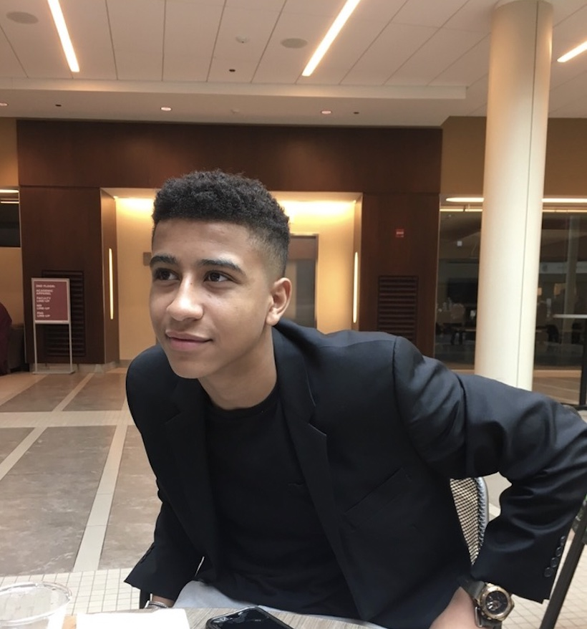
Alice Callejas is a junior at the University of Illinois at Chicago majoring in Finance. She grew up in Waukegan, Illinois, and graduated from Fenton High School. Her interests include painting, reading, and traveling. Her career goal is to work as a financial advisor in the banking industry and to make a difference in the Hispanic community.
Francisco Chavez is a junior at Illinois Institute of Technology majoring in Computer Science. He grew up in Joliet, Illinois and graduated from Joliet Central High School. His interests include fishing, learning trivia, and researching machine learning innovations. His career goal is to develop and deepen the understanding of artificial intelligence.
Beemnet Desta is a junior at DePaul University majoring in Data Science. She grew up in Ethiopia and graduated from School of Tomorrow. Her interests include traveling, music, watching shows and volunteer work. Her career goal is to become a data analyst.
Isaac Diop is a senior at the University of Illinois Urbana-Champaign majoring in Finance and Financial Planning. He was born in Chicago but grew up in Rome, Italy, and graduated from Evanston Township High School. His interests include traveling the world and exploring financial markets. His career goal is to open his own investment firm and provide financial literacy education.

Slide 7
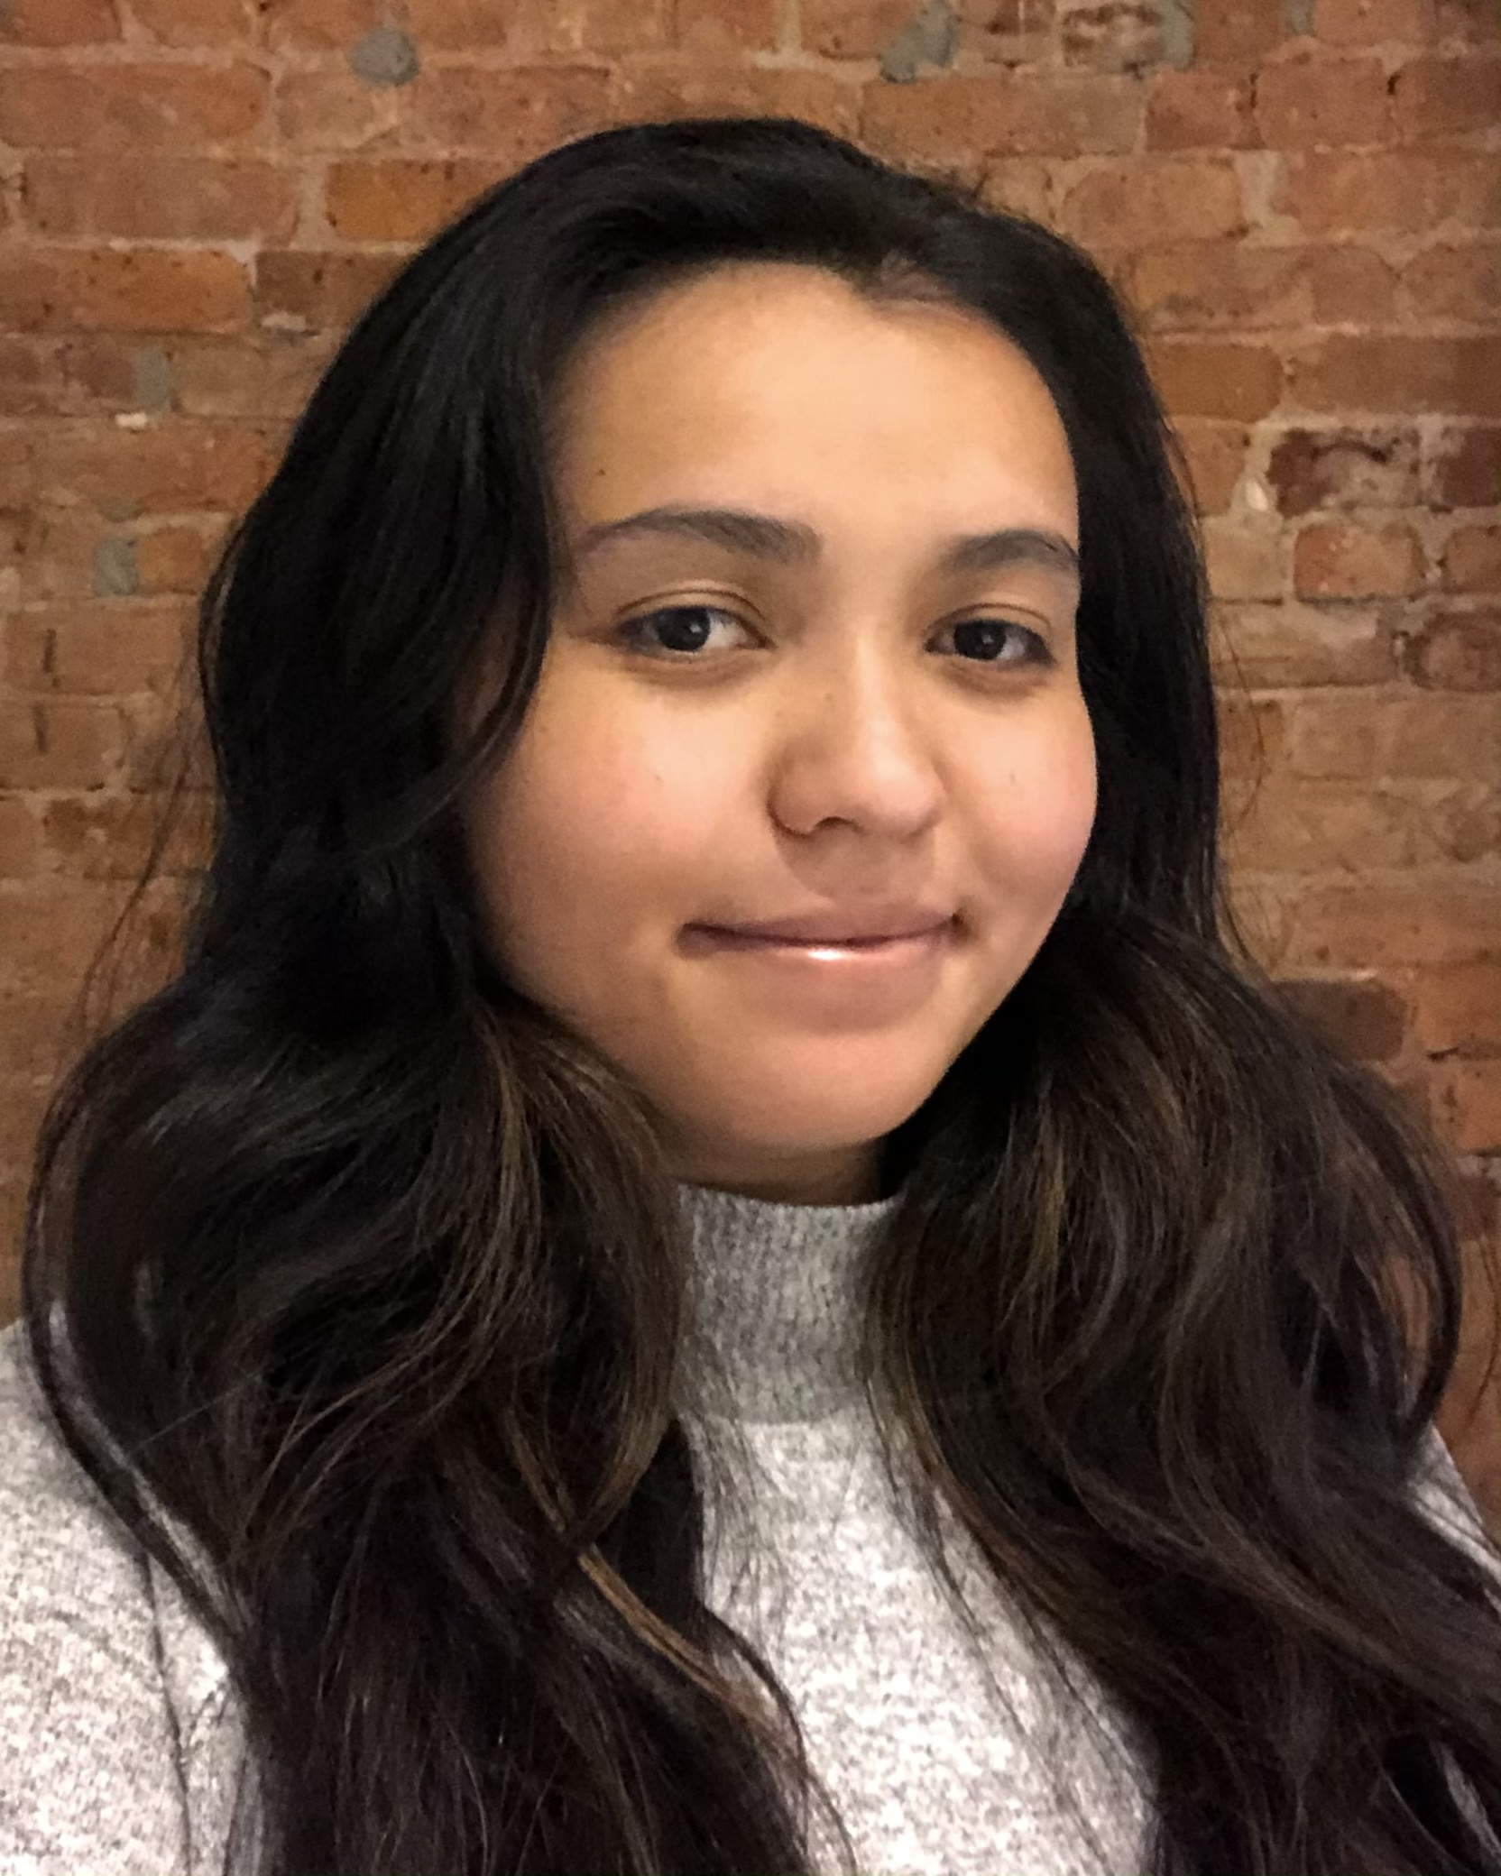
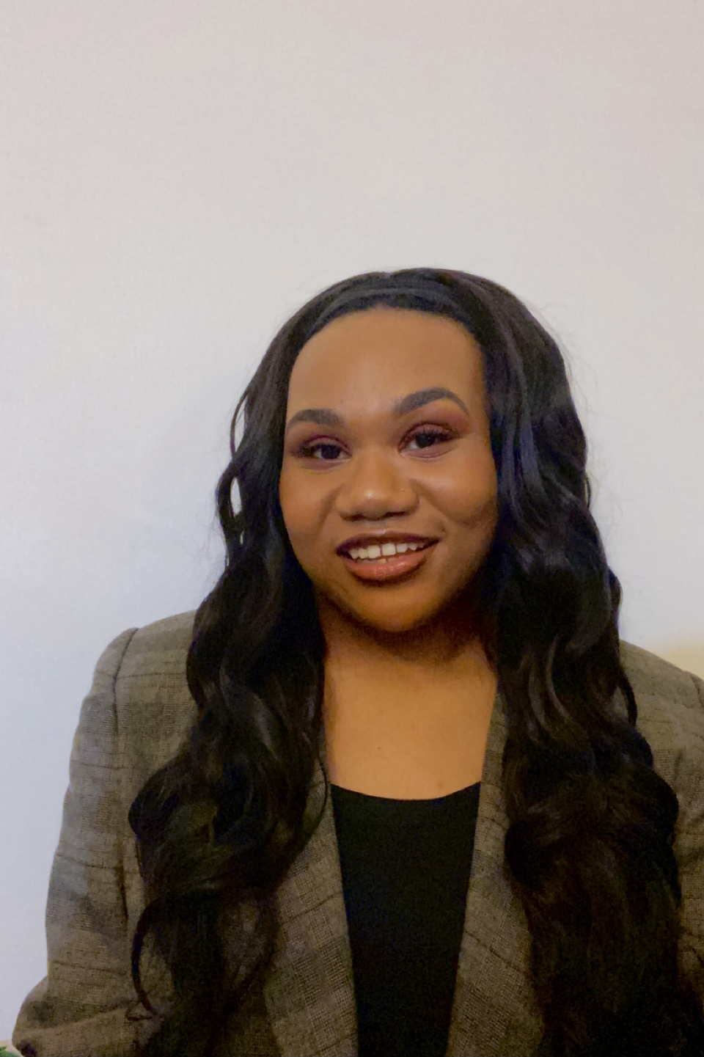
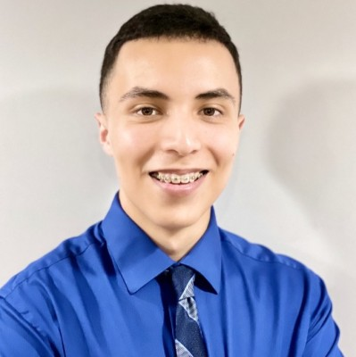
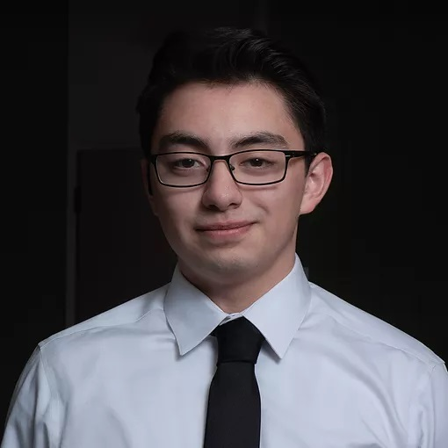
Katrina Eggleston is a senior at Stevens Institute of Technology majoring in Quantitative Finance. She grew up in Eatontown, New Jersey, and graduated from Communications High School. Her interests include music, graphic design, and fashion. Her career goal is to be CFO of a major company she loves.
Sanaa Hill is a junior at Loyola University Chicago in fall 2021 majoring in Business Finance and Marketing. She grew up in Racine, Wisconsin, and graduated from Walden III High School. Her interests include performing as a member of the Loyola Afrodescent dance team, active member of Loyola's Black Cultural Center, and mentee of the Loyola University Chicago Empowering Sisterhood (LUCES) program. Her career goal is to create a more inclusive business market.
Anthony Huerta is a junior at University of Illinois, Urbana-Champaign majoring in Computer Science. He grew up in Chicago before graduating from Riverside Brookfield High School. His interests include finance, programming, and learning about new technologies in development. His career goal is to work as a Software Engineer in the fintech industry.
Daniel Larios is a senior at the University of Illinois at Chicago majoring in finance with a minor in economics. He grew up in Oswego, Illinois and graduated from Oswego High School. His interests include investing, financial markets, soccer, and chess. His career goal is to eventually attain an MBA and work in corporate finance or in wealth management.

Slide 8
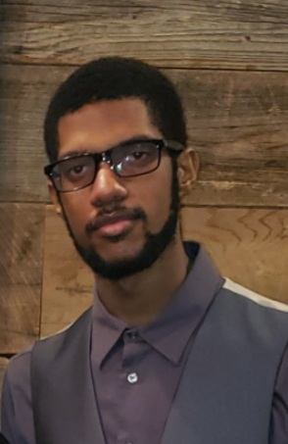
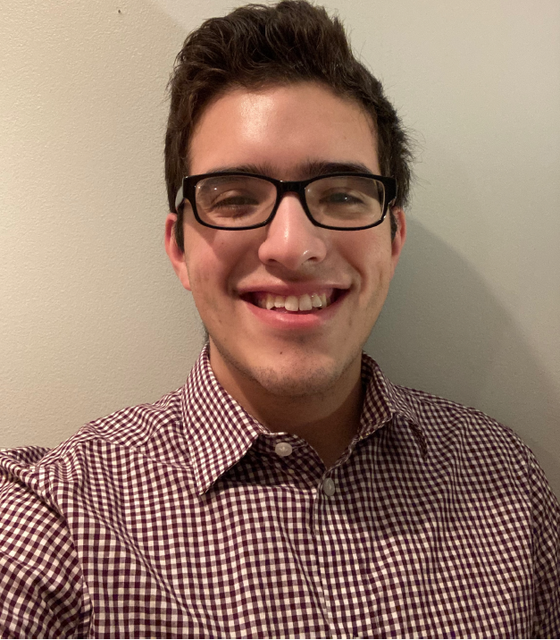
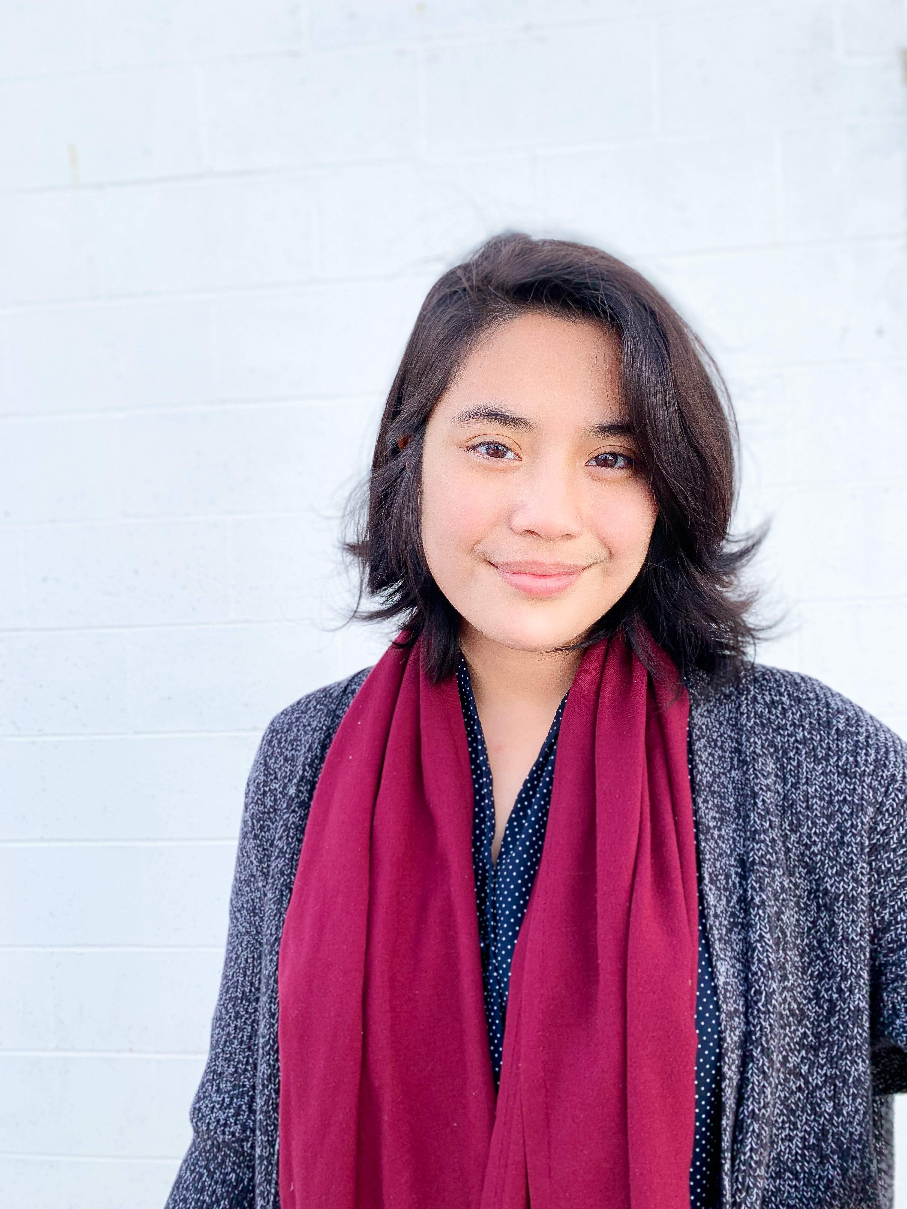
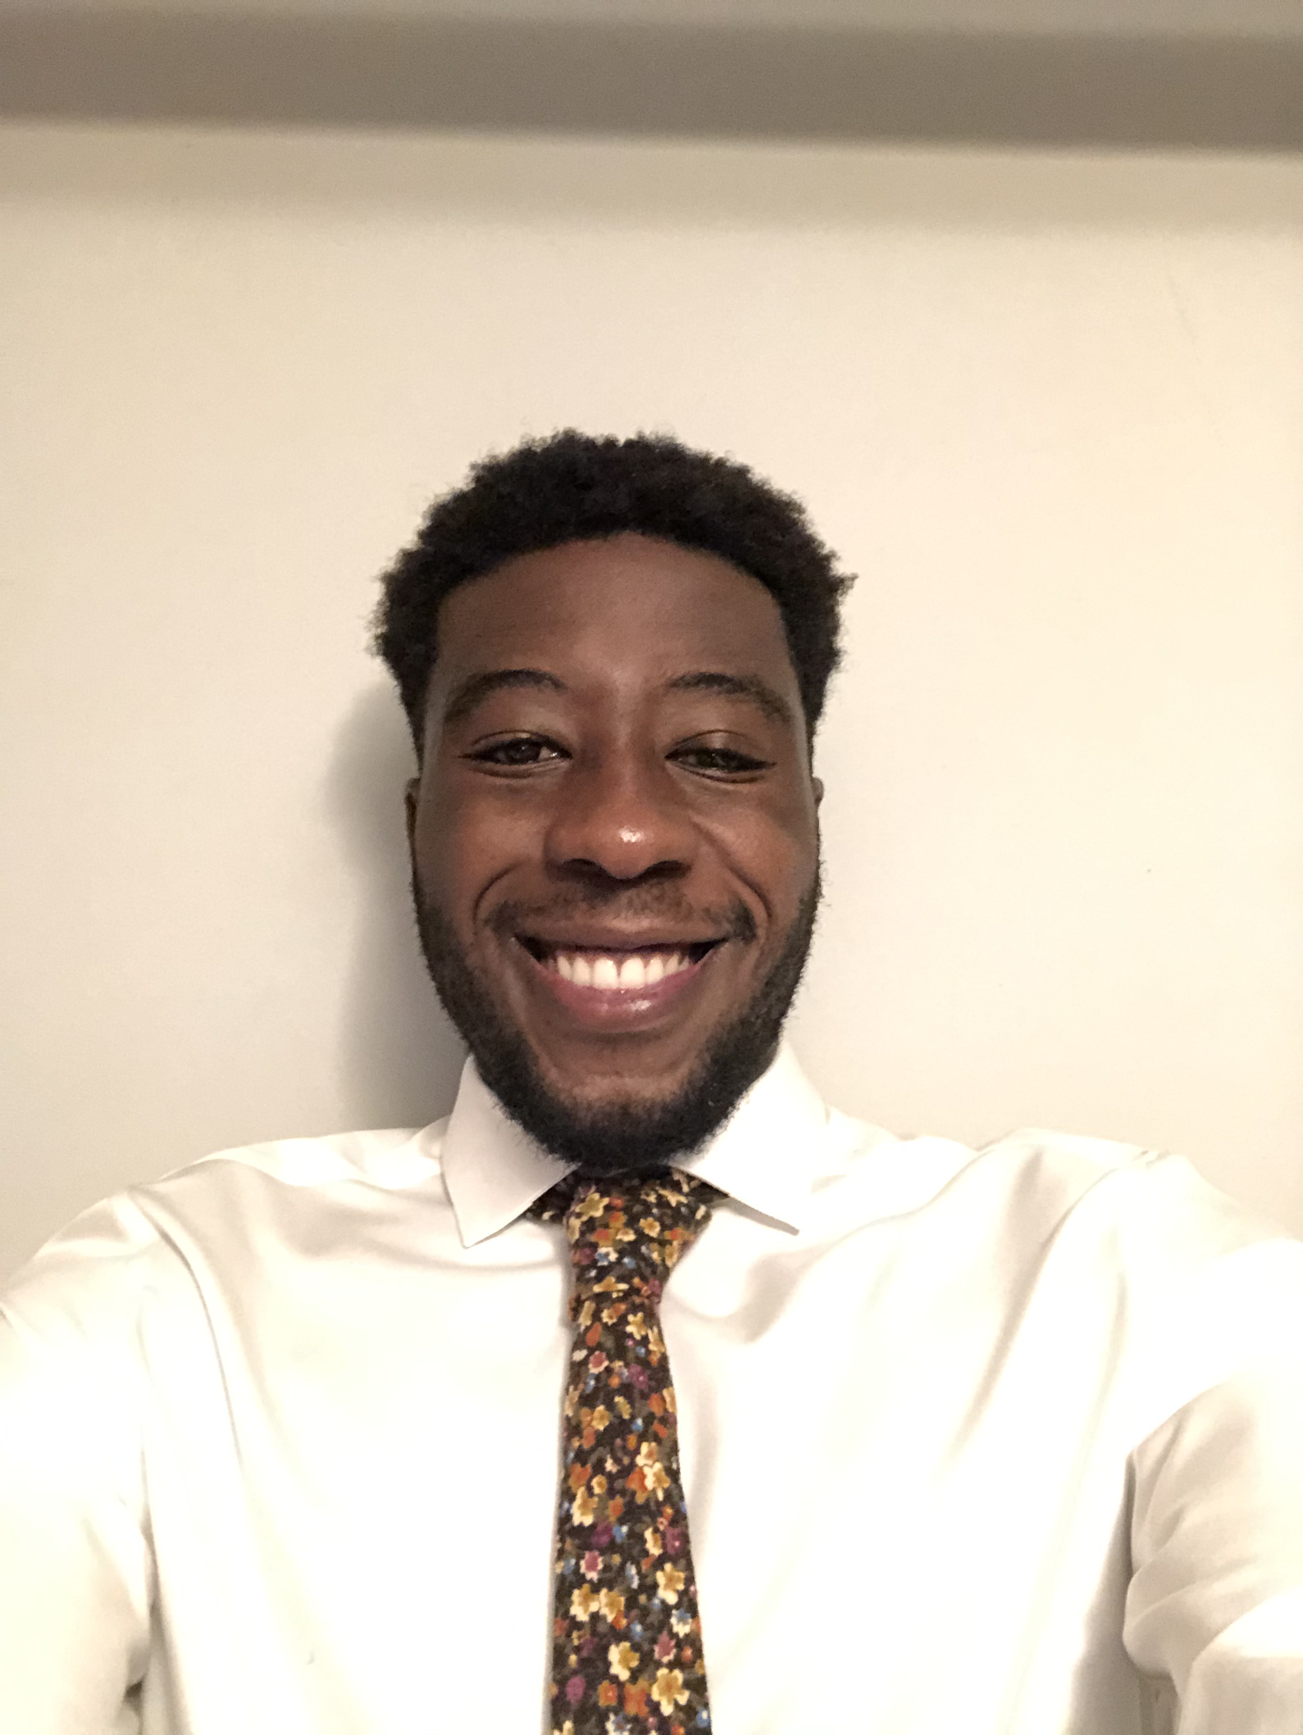
Armani LeSure is a senior at Illinois Institute of Technology majoring in Information Technology and Management. He grew up in Chicago and graduated from Lindblom MSA. His interests include music, games, movies and cooking. His career goal is to eventually gain enough experience so that he may become a successful IT manager.
Hugo Lopez will be a senior at University of Illinois at Chicago majoring in finance with a minor in entrepreneurship. He grew up in Chicago and graduated from Lane Tech High School. His interests include working on cars, working out, and advising/helping people/business. His career goal is to help companies build successful businesses through proper financial management.
Tina Lopez is a senior at the University of Illinois at Urbana-Champaign majoring in finance. She grew up in Chicago and graduated from Disney II Magnet High School. Her interests include entrepreneurship, leadership, and spirituality. Her career goal is to bring more wealth to BIPOC individuals through entrepreneurship, finance, and business.
Jason Malonga is a senior at DePaul University majoring in Finance. He grew up in Bolingbrook, Illinois and graduated from Benet Academy. His interests include playing basketball, spending time with family, and video games. His career goal is to start a non-profit that focuses on furthering the education of kids in Africa, while also pursuing the goal of becoming a portfolio manager at a hedge fund.

Slide 9
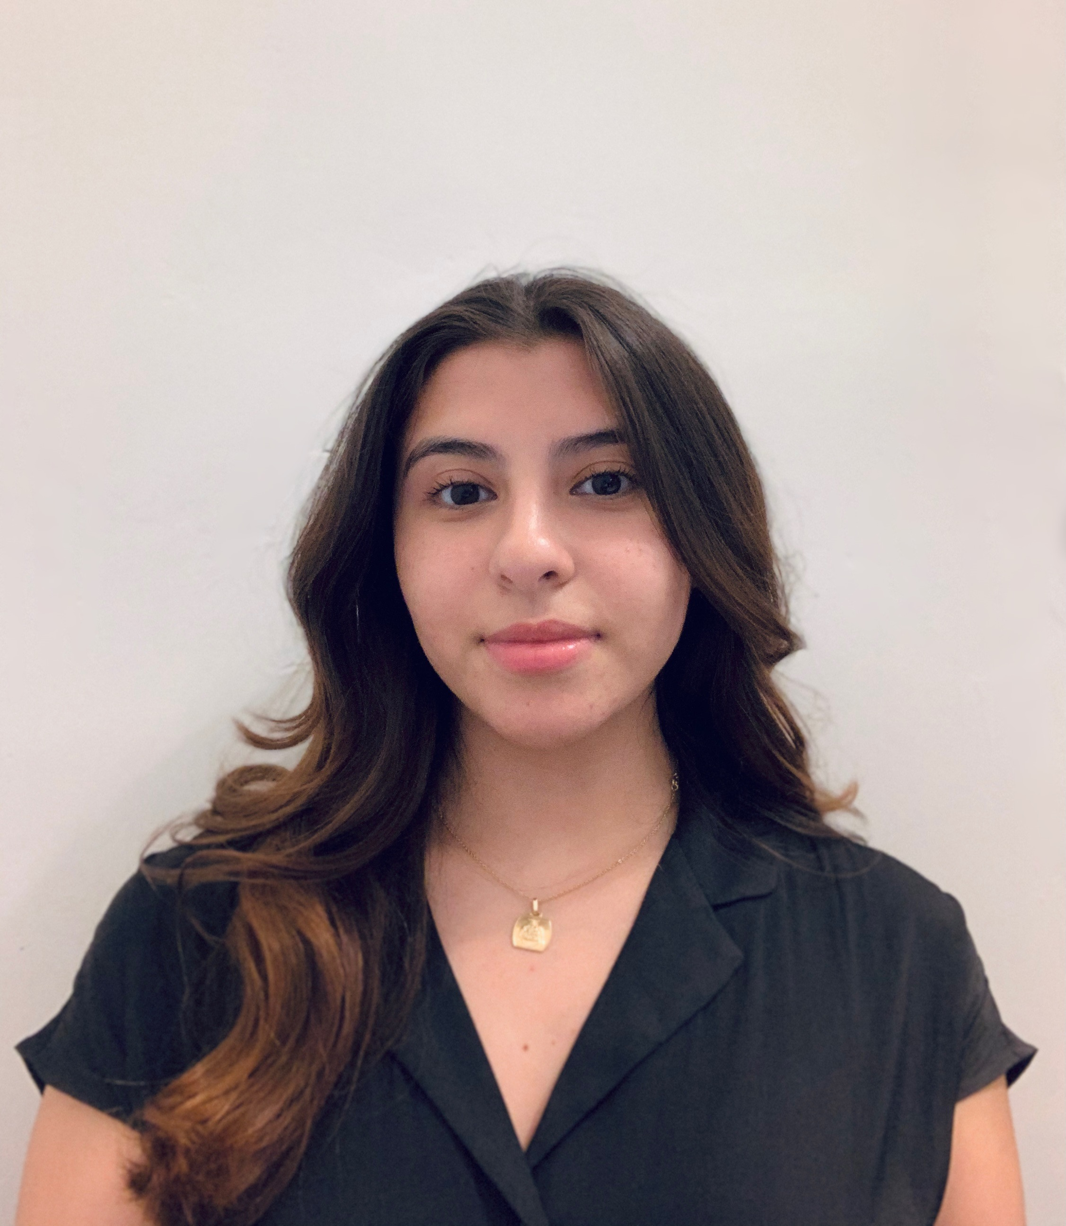
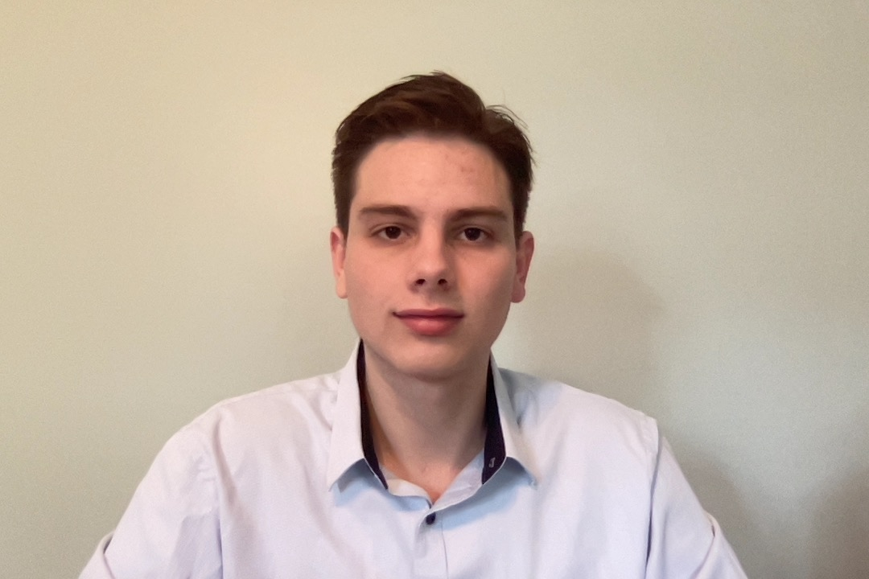
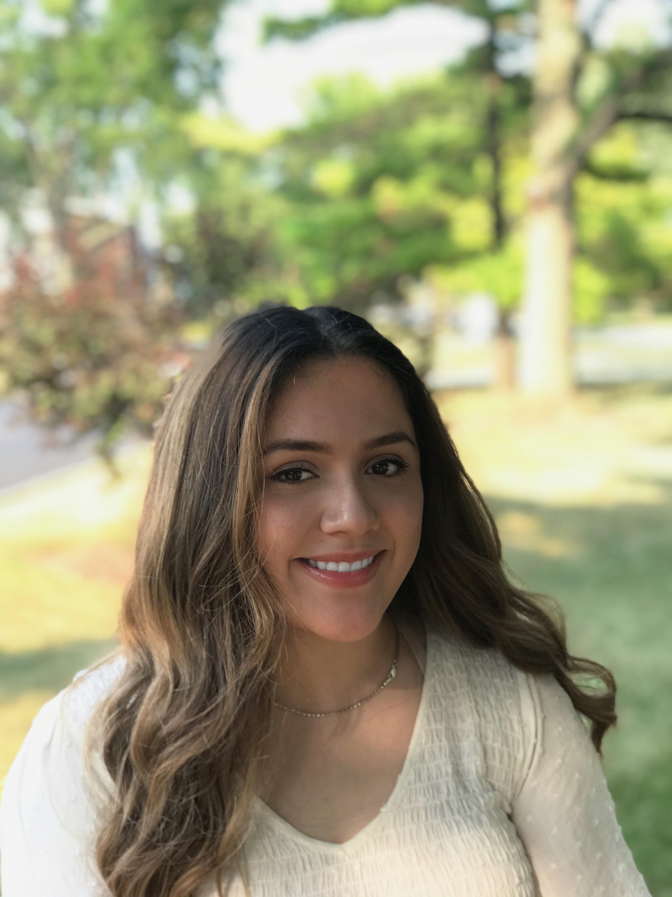
Paige Morton will be a senior at Loyola University Chicago majoring in Mathematics. Paige grew
up in Carol Stream, IL and attended Glenbard North High School. Her interests include being a
mentor for women of color, participating in Loyola’s Black Cultural Center, and being an active
member of Loyola’s Mu Phi chapter of Zeta Phi Beta Sorority, Inc. Her career goals are to
become a data or financial analyst.
Fanny Munoz is a senior at the University of Illinois at Chicago majoring in finance. She grew up in Chicago and graduated from Westinghouse College Preparatory. Her interests include working out and biking. Her career goal is to work within an investment bank.
Ariel Nudman will be a junior at Loyola University Chicago majoring in Accounting and Finance. He lives in Chicago and graduated from Ida Crown Jewish Academy High School. His interests include running, reading, water sports, and traveling. His career goals as of now are to continue learning about the financial industry, to better understand all it has to offer.
Jessica Oliveros will be a senior at DePaul University, majoring in Computer Science. She grew up in Chicago and graduated from Downers Grove North High School. Her interests include making music and programming. Her career goal is to become a software engineer.

Slide 10
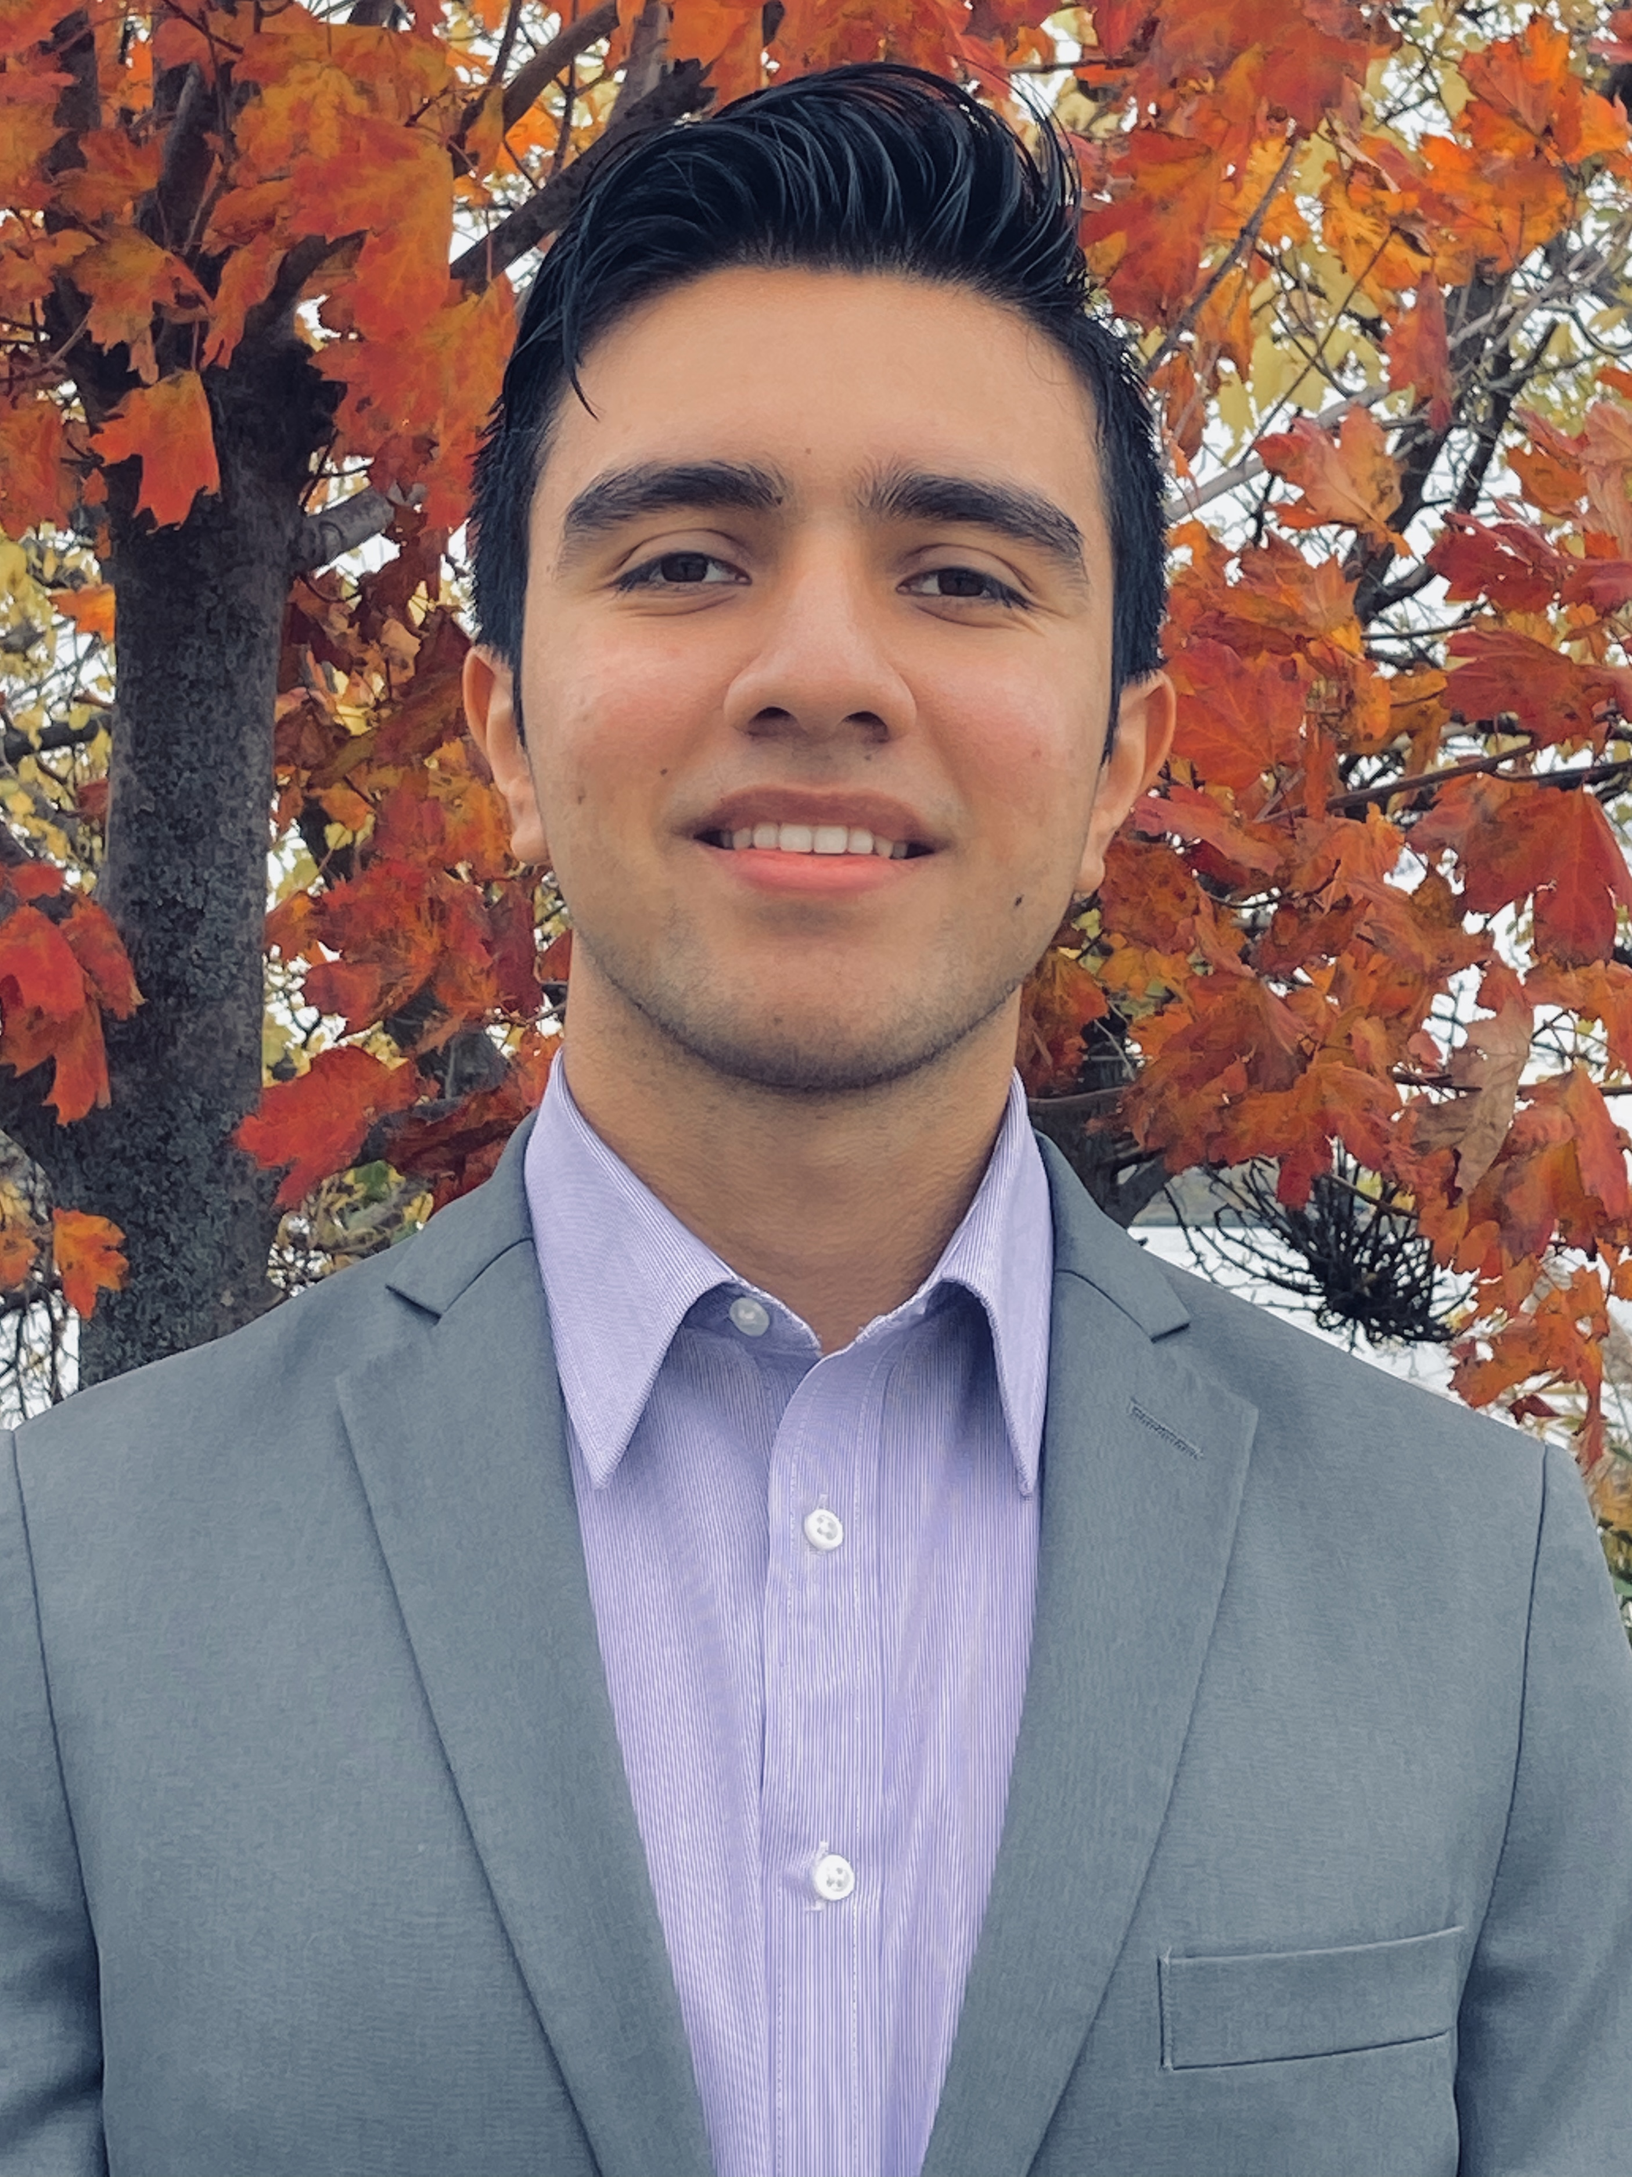
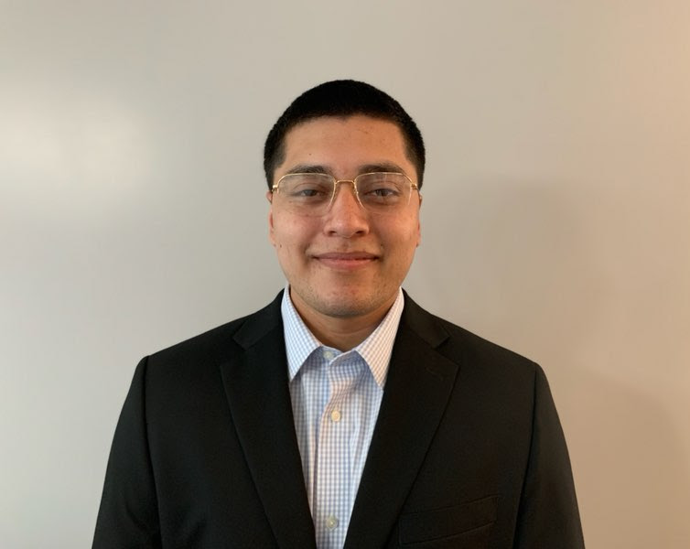
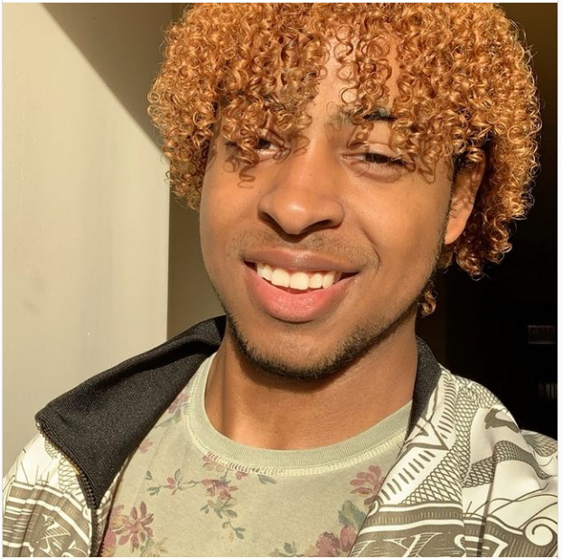
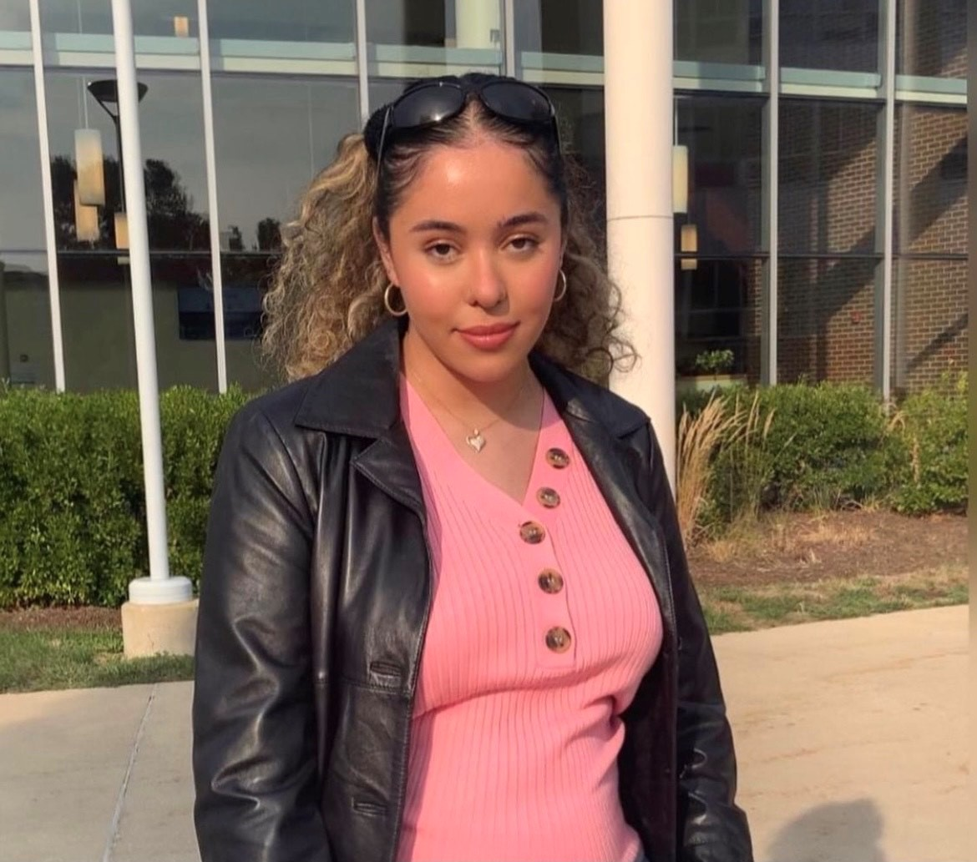
Julian Pacheco is a senior at the University of Illinois at Chicago majoring in Finance and IDS. He grew up in Chicago and graduated from Jones College Prep. His interests include competing in tennis and baseball, and biking near lake Michigan. His career goal is to work in the financial services industry and make a lasting impact on those he meets.
Sergio Palomino is a senior at the University of Illinois at Chicago majoring in finance. He grew up in Chicago and graduated from Curie Metropolitan High School. His interests include hiking and swimming. His career goal is to become an investment banker.
Zion Powell is a senior at Saint Xavier University, majoring in Computer Science and Computer Information Systems. He grew up in Harvey, Illinois, and graduated from Thornton Township High School. His interests include computers and technology. His career goal is to secure a full-time job at CME Group.
Aiah Radwan is a junior at the University of Illinois at Urbana-Champaign majoring in Finance. She grew up in Urbana, Illinois and graduated from Urbana High School. Her interests include soccer, ping pong and cooking. Her career goal is to become a financial consultant and create a not-for-profit that helps educate financial literacy.

Slide 11
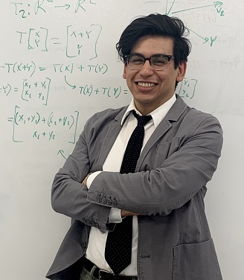
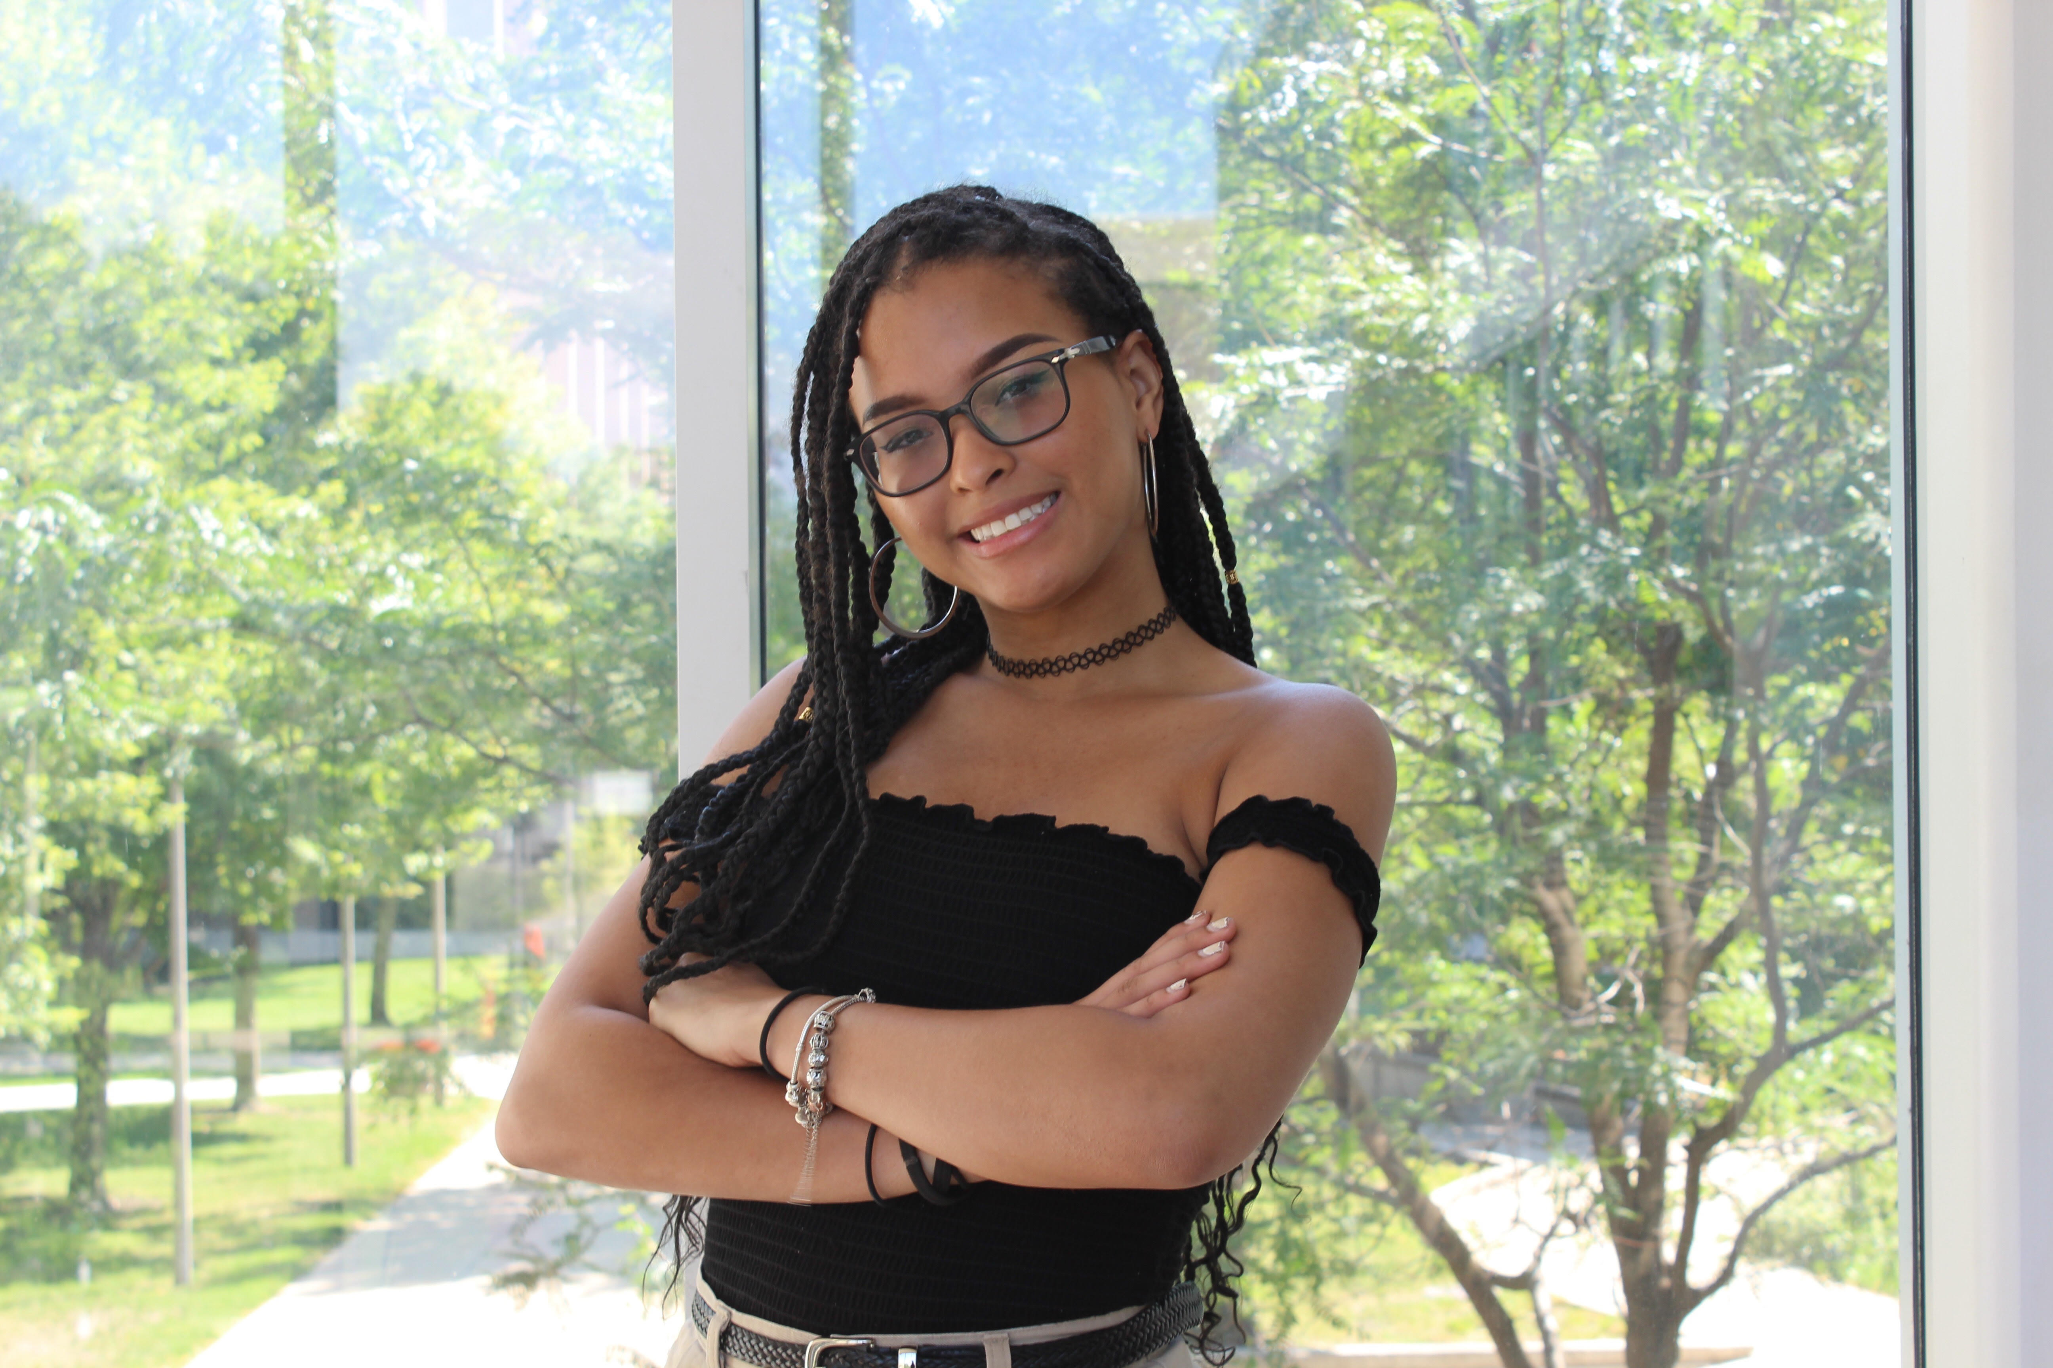
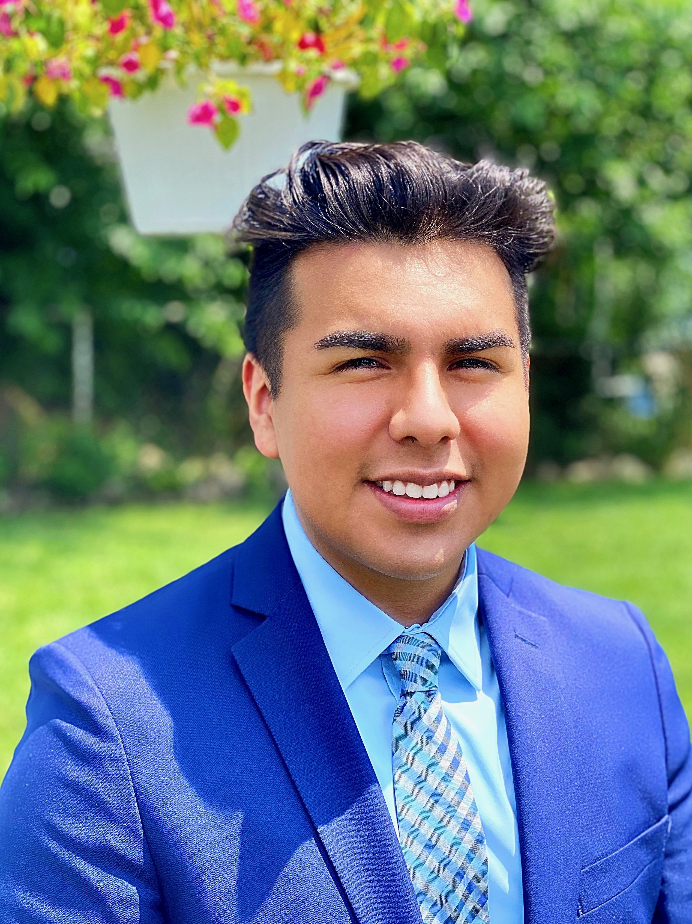
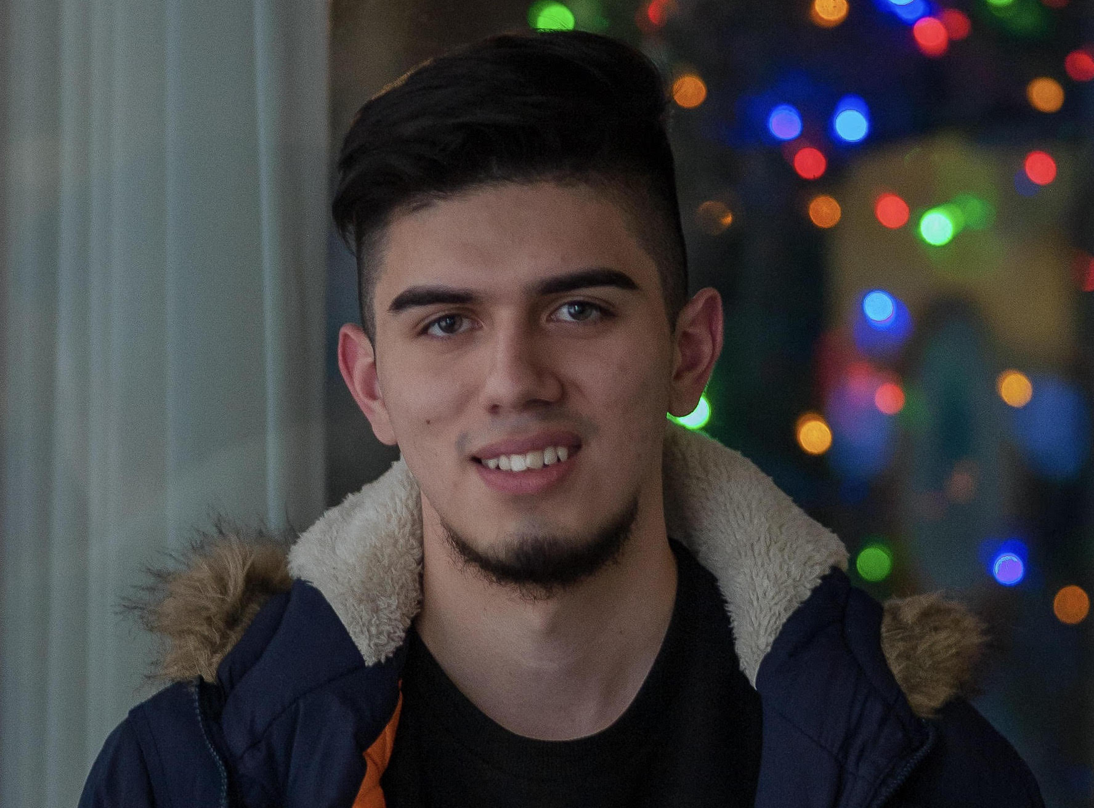
Hernan Razo will be a 5th year co-terminal degree student at the Illinois Institute of Technology working on his bachelors and masters degree in computer science. He grew up in Chicago and graduated from the Chicago Math and Science Academy. His interests include biking and reading. His career goals are to work in artificial intelligence and data science.
Noelle Robinson will be a junior at the University of Illinois at Chicago, double majoring in Finance and Information Decision Sciences. She grew up in Chicago and graduated from Mizzou Academy High School. Her interests include browsing the wealth of knowledge online, tutoring her peers, and teaching personal finance to young adults. Her career goal is to use data in a meaningful way.
Thomas Rueben Rocha is a senior at University of Illinois at Chicago majoring in Finance. He grew up in Romeoville, IL and graduated from Romeoville High School. His interests include running, working out and reading. His career goal is to become a personal financial analyst and planner.
Carlos Rodríguez is a senior at Illinois Institute of Technology majoring in Computer Science. He grew up in Chicago and graduated from Westinghouse College Prep. His interests include civic tech and engagement. His career goal is Product Management.

Slide 12
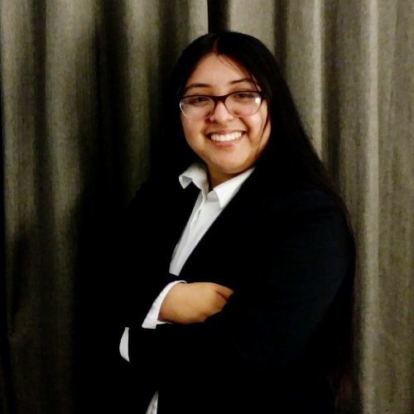
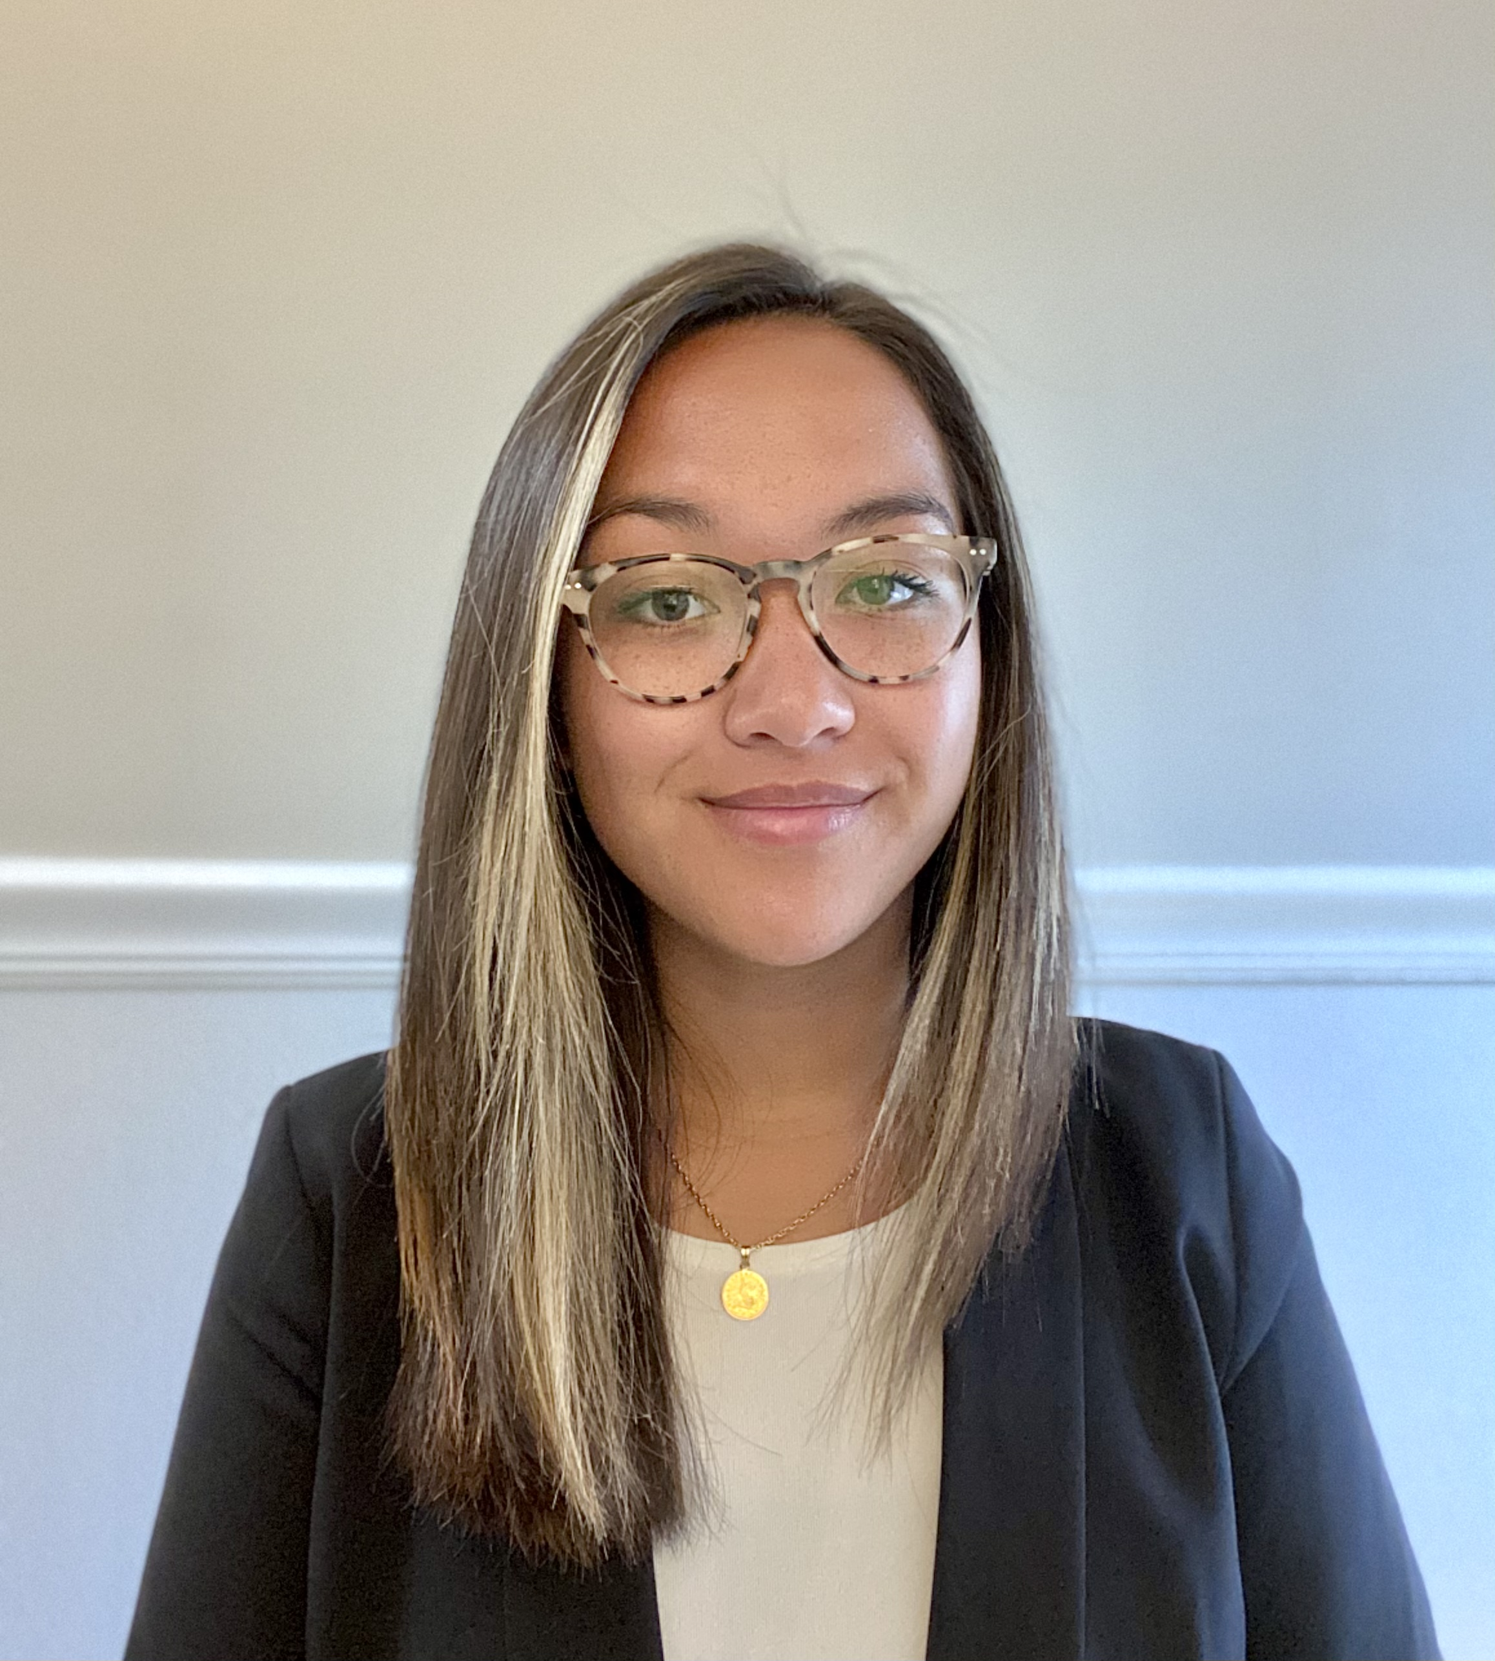
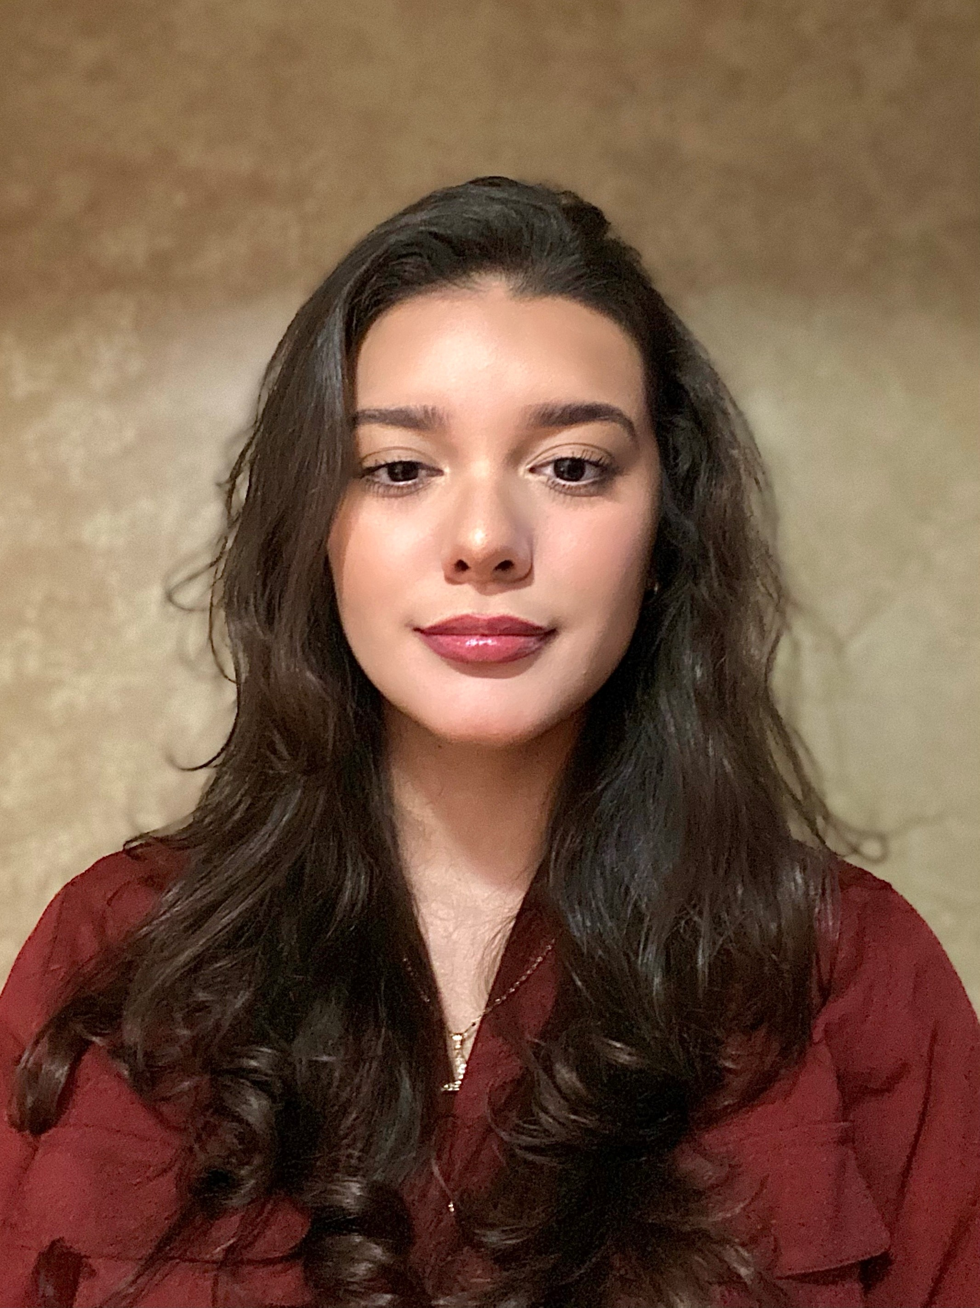
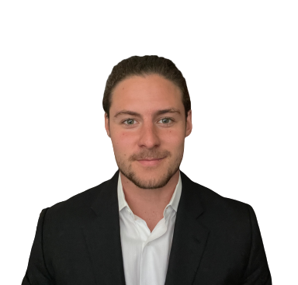
Gladys Toledo-Rodriguez is a 4th year at Illinois Institute of Technology majoring in Computer Science. She grew up in Chicago and graduated from Lane Tech College Prep. Her interests include cooking, teaching, and learning new things from languages to software. Her career goal is to become a software engineer.
Jordan Torres is a senior at Stevens Institute of Technology majoring in Finance, with a minor in Quantitative Finance. She grew up in Jackson, New Jersey and graduated from Jackson Liberty High School. Her interests include performing with her band Phoneboy, hiking, and gardening. Her career goal is to work as a financial analyst or advisor in the music/entertainment industry, and eventually open a music school.
Vivianna Torres is a junior at the University of Illinois-Chicago majoring in Finance. She grew up in Chicago and graduated from Lane Tech College Prep High School. Her interests include photography and working to expand her knowledge about the financial services industry. Her career goal is to work in either commercial banking or an area related to investments.
Lorenzo Trentini is a senior at Loyola University Chicago majoring in Computer Engineering. He grew up in Porto Alegre, Brazil and graduated from Temecula Valley High School. His interests include soccer, guitar, golf, and building a sustainable future for smart power grids. His career goal is to design electrical components and upgrade the power grid so power outages can become a thing of the past.

Slide 13
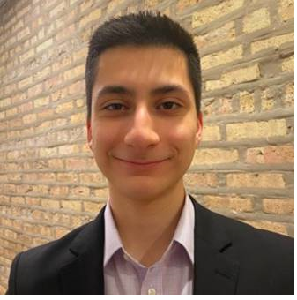
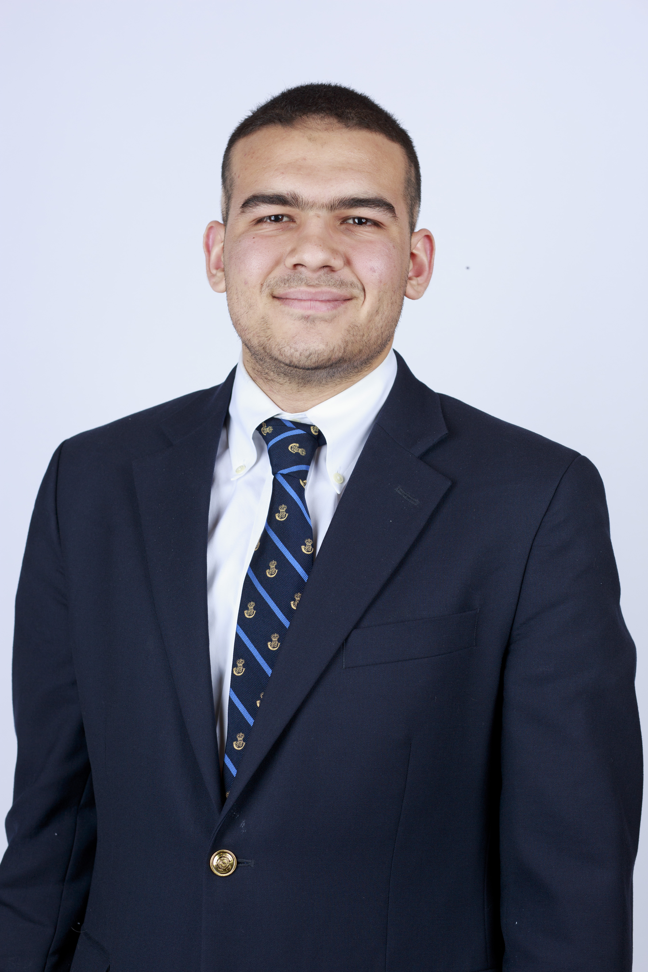
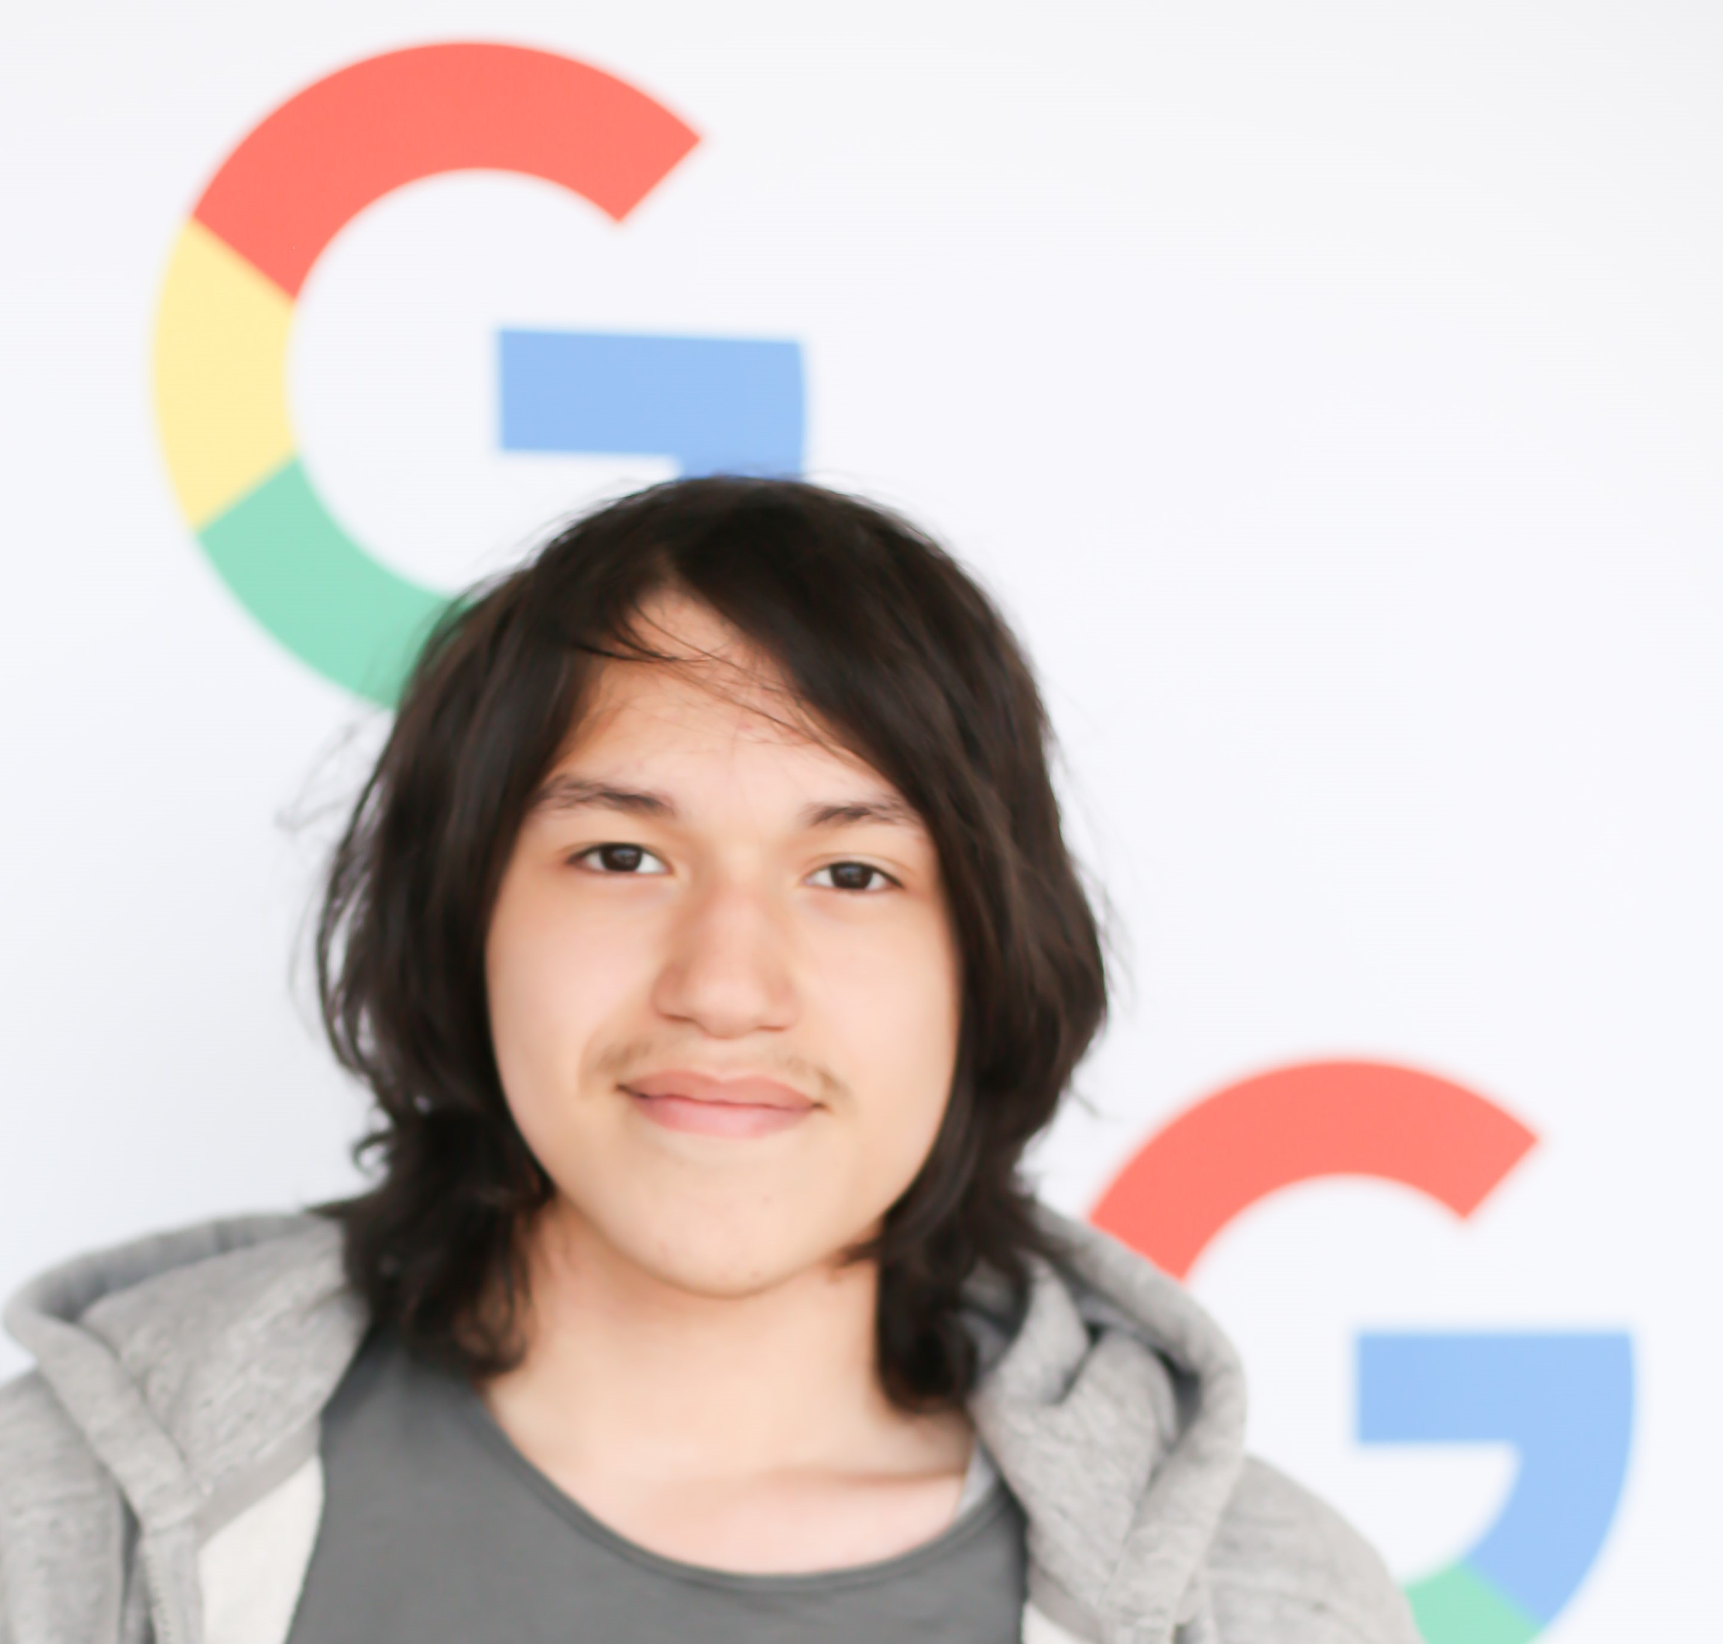
Jovad Uribe is a junior at University of Illinois at Chicago majoring in Data Science. He grew up in Chicago and graduated from Lane Tech High School. His interests include paintball, reading, and coding. His career goal is to work as a quantitative trader.
Marco Aurelio Useche is a senior at Loyola University Chicago, majoring in Supply Chain Management. He grew up in Orlando, FL and graduated from Freedom High School. His interests are politics, law, financial markets, agricultural trading and the sports industry. His career goal is obtaining an MBA/JD degree, and to be CEO of a large food/beverage industry or president of operations for a Major League Baseball organization.
Benny Vazquez-Elvir is a senior at Illinois Institute of Technology majoring in Computer Science. He grew up in Chicago and graduated from Lane Tech College Prep. His interests include gaming, coding, and reading books. His career goal is to become an entrepreneur and help people around the globe.
Daniel Velarde is a senior at Loyola University Chicago studying Finance with minors in Information Systems and Spanish. He grew up in Carterville, Illinois and graduated from Carterville High School. His interests include investing, books, and travel. His career goal is to work in the commodity market or corporate finance and eventually become a professor teaching finance.

